Slide 1
An HIV Post-Exposure Prophylaxis Pilot Program Implemented in Public Health Settings in Los Angeles
Jennifer N Sayles, MD, MPH, Gary P García, MPH, Rosemary C Veniegas, PhD, Robert K Bolan, MD, Wilbert C Jordan, MD, and Raphael J Landovitz, MD, MsC

Slide 2
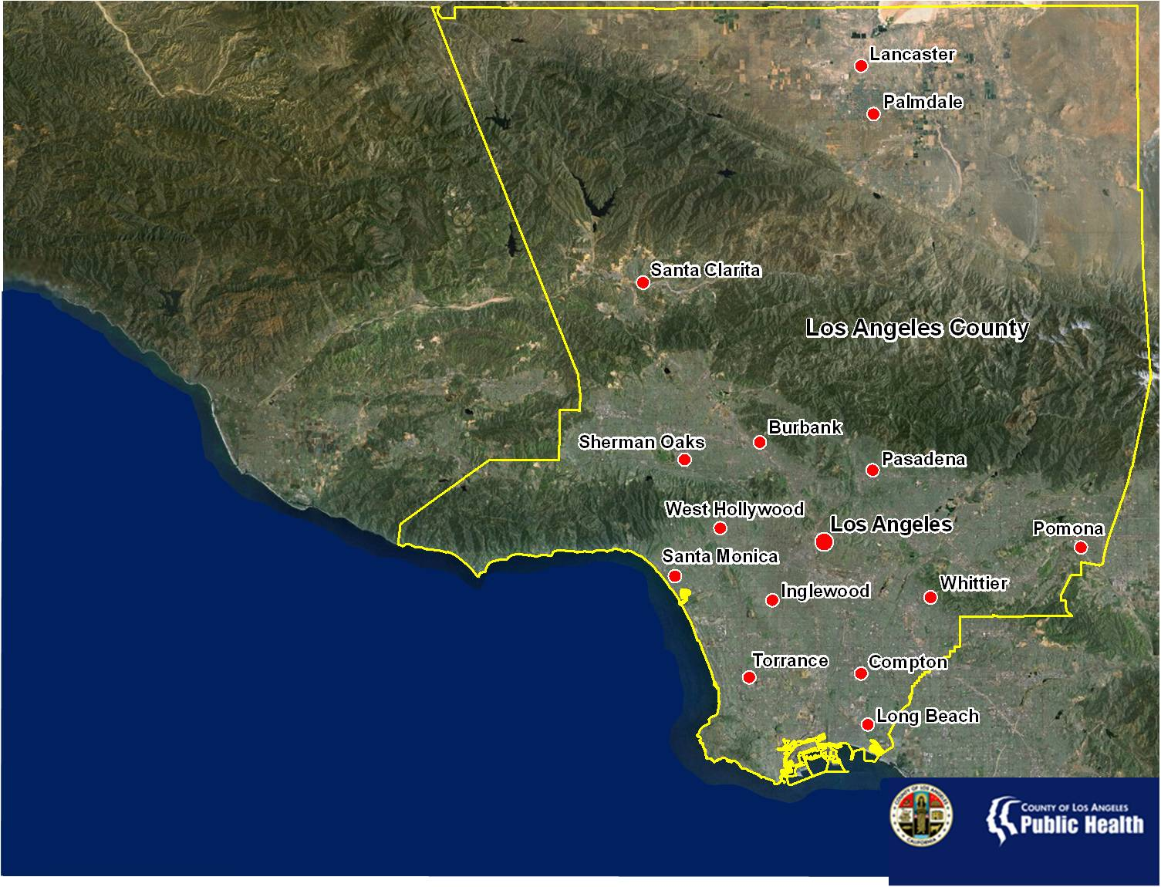
Population | Estimated HIV/AIDS Cases
9,848,011 | 61,700
Data Source: U.S. Department of Commerce, 2010; Los Angeles County Department of Public Health, HIV Surveillance, 2010
Notes:
Since this presentation will focus on implementation of nPEP in LA County, I wanted to start with a bit of background about our jurisdiction. Los Angeles County is the most populous in the United States with 9.8 million residents. The County is diverse in both it’s people and geography, it spans over 4000 square miles, and consists of urban, suburban, and rural areas divided by several mountain ranges. There is no one majority racial/ethnic group, however, latino’s are the plurality in LA County, with Whites making up the second largest racial/ethnic group. Interms of HIV/AIDS cases, Latinos also make up the largest overall number and proportion of those infected, however African Americans and to a lesser extent whites, are disproportionately infected with HIV.

Slide 3
A Case for nPEP?
A 26 year old man presents to an outpatient clinic, reporting that the night before last (36 hours ago) he had receptive anal intercourse without the use of a condom with a new male partner, who he just learned from a mutual acquaintance is infected with the Human Immunodeficiency Virus (HIV). The patient is known to the clinic and has had several negative HIV tests (most recently 6 months ago), and he recently lost his job and health insurance. He wants to know if there is anything he can do to help prevent transmission of HIV from this recent exposure.
Notes:
I’d like to start with a case to frame the context in which the need for nPEP may arise. This case is one of a few that came to the attention of the health dept in LA several years ago, and was an impetus for the efforts in LA county to develop and implement a publicly funded nPEP program.

Slide 4
Approach to HIV Prevention
Coates, Lancet, 2008
Notes:
So what does this patient need? From our perspective, this individuals and others like him are in need on “highly active HIV prevention”. This includes a comprehensive intervention that is composed of a biomedical intervention, nPEP, screening and treatment of concominant STIs, risk reduction counseling, screening and referral for mental health and substance use disorders, and need for other services.

Slide 5
LA County nPEP Genesis
OAPP
LAC STD
PPC
P-QUAD
Commission on HIV
Providers
Behavior/SA Specialists
CBO/CHCs
Academics
Notes:
Next I’d like to take a moment to describe the process by which LA County developed its nPEP pilot program, which was a collaborative process. The key partners are outlined here on this slide, including our office, OAPP…. This stakeholder group came together in the form of an LA County nPEP workgroup, which advised our office and collaboratively developed the model for a pilot nPEP program to be implemented in LAC.

Slide 6

Notes:
Now, moving on to the nPEP pilot program, which was named P Quad: i.e. 4 P’s: Post-exposure Prophylaxis Pilot Program. This is one of the informational materials developed for the program.

Slide 7
The nPEP Pilot: Comprehensive Biomedical HIV Prevention for LAC
2 demonstration sites; 28 days of ART
IRB and FDA regulatory oversight
Structured Protocol and Manual of Procedures
Demonstration site preparation and training
Safety labs and serial HIV and STI testing
Sexual/substance use risk-reduction counseling
Planned transition to Public Health Service Model
Notes:
To begin with an overview, the nPEP program was implemented fro 12 months at 2 demonstration sites, and 28 days of ART. The program was under IRB and FDA regulatory oversight. A structured protocol and manual of procedures was developed, as well as intensive site preparation and training/technical assistance. As a part of the program, safety labs and serial HIV and STI testing were performed, in addition to sexual and substance use screening and risk reduction counseling. The goal of the pilot program was to provide acceptability and feasibility data, such that if implementation of the pilot was successful there would be a planned transition to a sustained public health service model

Slide 8
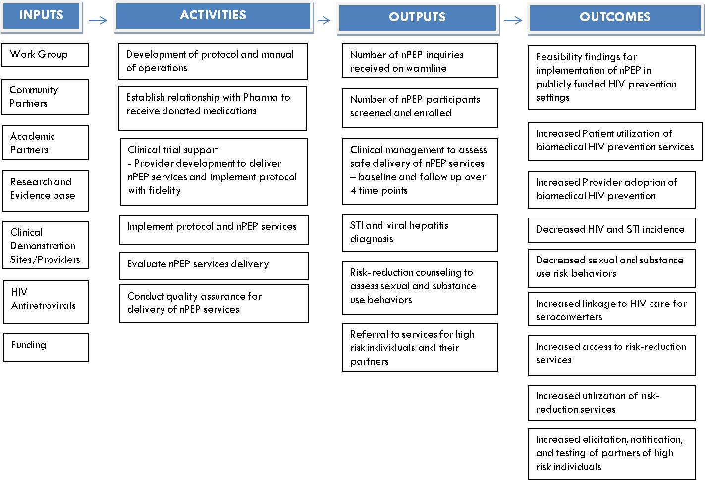
nPEP Logic Model
Notes:
This slide shows the logic model that was created for the nPEP program. I don’t have time to walk through all the components, but I wanted to include it to point out it was developed and was part of the process of developing and disseminating information about the nPEP pilot program.

Slide 9
nPEP Pilot Components
 | Baseline (Day 0) | Week 2 Visit (Day 10-14) | Week 4-6 Visit | Week 12 Visit | Week 24 Visit
ART Dispensed | X | X
HIV ELISA^{c} | X |  | X | X | X
Urine GC/CT Rectal GC/CT Pharynx GC | X | X^{b} | X^{b} | X^{b} | X^{b}
Serum RPR | X |  |  | X
Urine HCGª | X | X^{b} | X^{b} | X^{b} | X^{b}
HBsAg | X
CB, Cr, LFTs, | X | X^{b}
HIV Viral Load
HIV Genotype
Stored Plasma^{d} | X |  | X | X | X
Adherence Cnsl | X | X
Drug and Alc Assess | X
Risk Assess | X |  | X | X | X
Risk Red (Standard) | X | X | X^{b} | X^{b} | X^{b}
Referral to Behavioral Programming (Expanded) | X
ªFemales of childbearing potential only
^{b}If clinical signs and symptoms direct, not routine
^{c}Positive or indeterminate rapid HIV ELISA testing will be confirmed with a serum Western Blot
^{d}Plasma will be drawn and stored at indicated time points. If HIV seroconversion occurs, these samples will be run for HIV RNA (viral load) and genotyping
Notes:
This table outlines the major components of the nPEP pilot, these include ART- the nPEP regimens, HIV testing (rapid), Urine, rectal, and pharyngeal GC/CT screening at baseline and then as needed based on exposure or symptoms at follow up visits. Syphilis screening were at baseline and 3 months, and urine pregnancy test, hepatitis B screening and safety labs were performed at baseline. Plasma was also collected at each visit for storage, which enabled us to run viral loads and genotypes on any seroconversions. Additionally, adherence counseling was performed at baseline and 2 weeks, drug and alcohol assessments occur at baseline and necessary referrals made, HIV risk assessment and risk reduction counseling was performed at each visit, as well as referral to more intensive risk reduction counseling outside of the program when needed.

Slide 10
Inclusion Criteria
18 yrs of age and ability to provide consent
High-risk exposure (unprotected or with failed condom):
Receptive/Insertive anal intercourse
Receptive/Insertive vaginal intercourse
Receptive oral intercourse w/ejaculation with HIV+ source
Sharing intravascular injection drug works
High-risk source (one or more):
Known HIV+, MSM, MSM/W, IDU, CSW, sexual perpetrator, history of incarceration, from an endemic country (prevalence >1%), partner of one of the above
Exposure within 72-hrs of presentation
Not known to be HIV+
No countermanding concomitant medications or allergies
Notes:
The inclusion Criteria for nPEP were based on the CDC guidelines but with a slightly more narrow definition of high risk exposure, and are as follows

Slide 11
Medication Regimens
Standard ART Regimen for high-risk exposures:
Truvada
Combivir – for intolerance to Truvada
Expanded ART Regimen:
For highest-risk exposures or suspected source drug resistance; added to the above medication administration
Kaletra or Raltegravir
Notes:
The regimens were provided thru pharmaceutical company donation for the pilot program, and included …

Slide 12
Preliminary Findings
Presentation data as of July 1, 2011
Screened 303, Enrolled 283
Data to follow N=163 (151 at Site 1, 12 at Site 2)
N=38 had already initiated PEP at another location (ED, Primary Care, HIV clinic)
Site 1: LAGLC – Los Angeles Gay and Lesbian Ctr
Screened 271, enrolled 260
Site 2: OASIS
Screened 32, enrolled 23

Slide 13

nPEP Sites, HIV/STI Clusters, 2009
Source: Semi-Annual Surveillance Report, 2008, HIV Epidemiology Program
Data Source: HIV Testing Services Data, CY2009; Zip Codes with <100 tests not included in analysis
Notes:
This map shows the location of the 2 sites in the County relative to HIV and STI disease burden. This map shows the 5 main HIV/STI disease burden areas. The colors represent % of overall HIV cases in the county, and as you can see the two nPEP sites are located in the 2 highest burden clusters: LAGLC is located in the central cluster which has 46% of the HIV/AIDS cases in the county, and OASIS is located in the south cluster, which has approximately 18% of the HIV/AIDS cases in the county.

Slide 14
Demographics: Gender and Age (N = 163)
Notes:
Interms of demographics of our sample, the vast majority, 93% were MSM, with 5% women and 2% transgender. In terms of age, the largest number of people were aged 20-30, about ¼ were 31-40, and 20% 41-50. relatively few in the program were under age 20.

Slide 15
Demographics : Sexual Orientation and Race/Ethnicity (N=163)
Notes:
80% of those in pilot reported they were gay, 8% bisexual, and 11% straight. 51% of the individuals were white, 34% were latino, 8% african american, and 3% Asian. Given that african americans are over 20% of new infections, they were clearly underrepresented interms of enrollment in the pilot program.

Slide 16
Demographics: Health Insurance and Education (N=163)
Notes:
72% uninusre, 23% private insurance. Because this was a pilot study and under IND and IRB regulation, we were ethically required to offer service to anyone requesting, including those with other payor source. Overall the group was well educated, with over 60% of individuals with a bachelors or some college education.

Slide 17
Enrollment Risk Exposure (N=163) (multiple category reply)
Notes:
In terms of risk exposure at enrollment, 56% of individuals indicated receptive anal intercourse, 35% reported insertive anal intercourse, 5% receptive vaginal intercourse, 3% insertive vaginal intercourse, and 1% receptive oral intercourse with ejaculation.

Slide 18
Baseline Sexual Risk Behavior URAI / UIAI Acts by Status of Partner
URAI last 30 Days
UIAI last 30 days
N=48
N=54
N=143
N=124
Notes:
This slide describes the total number of URAI and UIAI acts in the past 30 days according to status of partner at baseline enrollment into the nPEP program. On the left the pie chart shows 48 acts of URAI with HIV+ partners, and 143 acts with partners of unknown HIV status. On the right, we see that 54 UIAI acts were with HIV+ partners, and 123 with partners of unknown status.

Slide 19
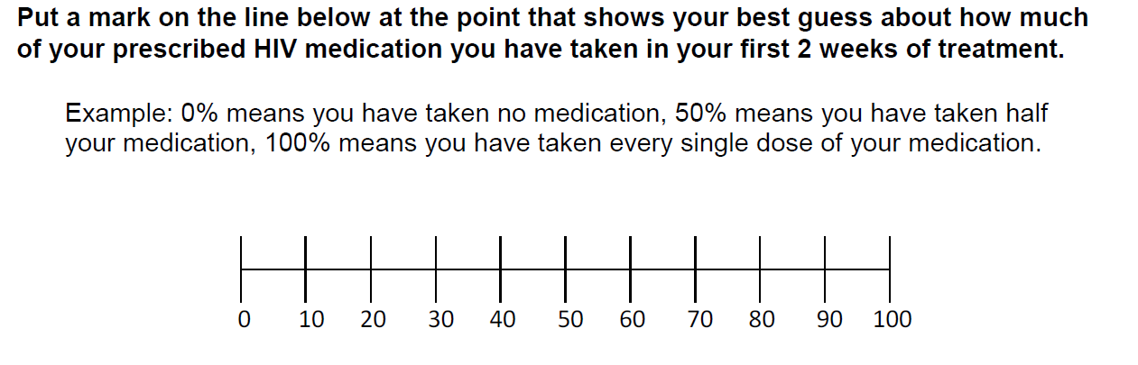
Medication Adherence by Visual Analog Scale
X
2 Week Clinical Evaluation
Mean self-reported adherence 96.90% (SD 12.81)
Range 7-100%
4 Week Clinical Evaluation
Mean self-reported adherence 96.57% (SD 11.32)
Range 0-100%
Notes:
We assessed self-reported adherence using a visual analog scale at both the 2 week and 4 week visits. Overall the self-reported adherence of the individuals in the program were extremely high: over 95% at both the 2 week and 4 week visits. However self-reported adherence has several limitations, including social desirability bias which frequently results in over-reporting pill taking adherence. However within the confines of resources available for this pilot project, this was the most practical measure to use, as Electronic Drug Monitoring and drug levels were beyond the scope of this implementation study.

Slide 20
Follow up Rates: Clinical Evaluations *N=163
Baseline | Day 14 | Week 4-6 | Week 12 | Week 24
163/163 (100%) | 146/163 (90%) | 131/163 (80%) | 98/161 (61%) | 62/161 (39%)
*As of July 1, 2011:
2 Significant Adverse Events: both continued treatment
Notes:
Follow up rates are outlined here, 80% of individuals followed up at 4-6 weeks, and 61% came to the week 12 visit. We see that follow up rates dropped of significantly at week 24, a visit focused on follow up HIV testing.

Slide 21
Time Interval: Exposure to First Dose *N=151
Mean: 36.33 hrs (SD 19.17)
Range: 2 – 71.7 hrs
* N=12 missing
Notes:
Here we see the distribution of time from exposure to receiving first dose of nPEP. The X axis represents the participant number, and the Y axis represents time in hours from exposure to dosing with nPEP. The mean time from exposure to dose was 36 hours, with a range from 2-71 hours.

Slide 22
Time Interval: Exposure to First Dose *N=151
Mean: 36.33 hrs (SD 19.17)
Range: 2 – 71.7 hrs
N=44 (27%) < 24 hrs
N=8 (5%)
< 8 hrs
* N=12 missing
Notes:
The arrows represent the 4 seroconversions that occurred in over the course of delivering nPEP to the first 150 patients. As you can see here, 3 of the 4 were after the mean 36 hour point.
8 patients received pep within 8 hours, 44 or 27% received nPEP within 24 hours, and as indicated here the 4 seroconversions were at 64 hours, 41 hours, 26 hours, and 62 hours
1016 (64 hrs); 1064 (41 hrs); 1101 (26 hrs); 1155 (62 hrs)

Slide 23
Seroconversions N=4
PID | Date Seroconversion identified | Exposure | Time to PEP | Med Adherence Self-Report | STIs | Repeat Exposures Self-Report
1016 | 12-week | URAI and UIAI w/recently seroconverted Source | 64hrs | 100% | None | None
1064 | 12-week | URAI and UIAI w/recently seroconverted Source | 41hrs | 100% | + GC at baseline | Yes
1101 | 12-week | UIAI with known HIV+ Source; Source reported to be undetectable on meds | 26hrs | 95% | None | Yes
1155 | 12-week | RAI with failed condom w/known HIV+ Source | 62hrs | 100% | Positive RPR 3 month | Yes
Notes:
Here we provide some detail on these seroconversions. All seroconversions were identified at the 12 week follow up. 2 of the 4 report unprotected receptive anal intercourse with known HIV+ source, and 2 of the 4 with recently seroconverting patients, who likely have extremely high viral loads and may be more potent transmitters. The time to PEP was already described and ranged from 26-64 hours. Adherence to nPEP by self report was high in all 4 seroconverters, although as previously discussed this may be an overestimation. 2 of the 4 had an STI, one with GC at baseline, and other w/a positive RPR at 3 months. 3 of the the 4 reported a repeat exposure between the baseline and 12 week period. This repeat exposure speaks to the challenge of administering PEP in the context of ongoing high risk behavior, and forces us to take a critical look at what the best prevention intervention may be for such patients. Should patient with multiple repeat exposures receive additional courses of nPEP, what we call “rePEP”? Are they good candidates for PEP at all? Are there other interventions behavioral or structural that they may benefit from instead? Should PEP become PrEP? These are all questions that we need to begin to address as we continue to make comprehensive biomedical HIV preventions available to those at highest risk.

Slide 24
nPEP Pilot: Summary
Demonstrated feasible implementation of nPEP in clinical care settings for high risk population
Real life example of how to develop and implement comprehensive biomedical and behavioral HIV prevention interventions
Cost of ART is significant and can be an obstacle to scaling up service delivery
Education for primary care (non HIV specialty) needed to support providers to deliver nPEP more broadly

Slide 25
Next Steps: Sustained nPEP Program
Public health program premised on the findings from pilot with few modifications:
2 drug regimen (Truvada) except in cases of documented drug resistance from source patient (3rd drug Raltegravir/Kaletra)
Integrated hepatitis screening and vaccination
Streamlined data reporting
PEP coordinator to do follow up visits
Full 28 day ART dispensed at intake
Integrated risk-reduction counseling via OAPP funded behavioral programs
Notes:
Public health program launched on May 25th

Slide 26
Acknowledgements
Gilead Sciences
Jim Rooney
Alexia Exarchos
Abbott Laboratories
Ashwaq Hermes
Judith Kruse
Merck Laboratories
Kathleen Bailey
Michael Harbour
GSK/Viiv
Gary Pakes
Sue Pippin
LA County OAPP
Mario Perez
LA County STD Program
Sarah Guerry
Peter Kerndt
LAC Public Health Lab
Debbie Emlien
Ramiro Garate
LAGLC Site Staff
OASIS Clinic Site Staff

Slide 27
Contact Information
Jennifer N. Sayles, MD, MPH
Medical Director
Office of AIDS Programs and Policy
600 South Commonwealth Avenue, 10th Floor
Los Angeles, California 90005-4001
Phone: (213) 351-8264
E-mail: jsayles@ph.lacounty.gov

