Slide 1
Toward Universal HIV Testing:
Is the CDC Recommendation of “Opt-out” Screening the Answer?
Jacqueline Rurangirwa, Anish Mahajan,
Saloniki James, Janni Kinsler,
Rishi Manchanda, Lakshmi Makam, Jennifer Sayles
National HIV Prevention Conference
August 15, 2011
Atlanta, GA

Slide 2
Collaborators/Acknowledgments
LAC DPH OAPP
Jennifer Sayles, MD, MPH
Jacqueline Rurangirwa, MPH
Saloniki James, MPH
Skip Crough, RN, PHN
Jan King, MD, MPH
Humphrey CHC
Lakshmi Makam, MD
Rita Ogbo, MD
Beverly Alexander, RN
Ida Carbins, RN
Stephen Puentes, MD
St. John’s CHC
Jim Mangia, CEO
RishiManchanda, MD, MPH
Ellen Rothman, MD, MPH
T.H.E. Clinic
Derrick Butler, MD
UCLA
Anish Mahajan, MD, MSHS, MPH
Martin Shapiro, MD, PhD
Honghu Liu, PhD
Janni Kinsler, PhD
Billy Cunningham, MD, MPH
Steve Asch, MD
Carol Mangione, MD, MSPH
Grant Support
Gilead Sciences, Inc.
CA HIV/AIDS Research Program
RWJF Clinical Scholars Program
CDC ETI Grant 07768

Slide 3
Background
United States
1.1 million HIV-infected persons
233,000 (21%) are unaware of their HIV+ status
56,000 new infections per year
Late HIV Diagnosis
33 – 50% have AIDS within 1 year of HIV diagnosis
  Blacks & Latinos more likely to test late
40 – 45% of all Americans have ever had an HIV test
  Testing usually is “risk-based” (USPSTF)
  Provider and patient barriers to risk-based testing
Campsmith et al MMWR 2008; Hall et al JAMA 2008;
CDC 2004; CDC 2003; LAC DPH 2004; MMWR 2010
Notes:
HIV in the United States is common. There are 1.2 million Americans infected with the virus.
Of the 1.1 million infected Americans 21% of those individuals are unaware of their HIV infections.
There are 56,000 new infections per year. And importantly, most of those new infections are transmitted by individuals who are unaware of their HIV positive status.
In addition to the high burden of undiagnosed infection driving the epidemic, we also have the problem of late diagnosis.
33 to 50% of individuals have AIDS within 1 year of HIV diagnosis. And Blacks and Latinos are more likely to test late.
Nationally, testing rates are low. Only 40 to 45% of all Americans report ever having an HIV test.
Testing is usually done according to the U.S. Preventative Services Task Force guideline recommending HIV testing only for patients deemed at risk for HIV. This is called “Risk-based testing”
There are numerous provider and patient barriers to risk based testing

Slide 4
Change in HIV Testing Guidelines
2006: CDC revised recommendations for HIV testing of adults in healthcare settings
2008: Change in California HIV Laws
  No longer require in medical settings:
    Separate written consent for HIV testing *
    Separate counseling session *
  Opt out testing in perinatal care now legal*
  HIV is reportable by name using CMR (responsibility of MD/NP/PA)
*California Health and Safety (H&S) Code Section 120990
Notes:
To address this, the CDC released revised recommendations for HIV screening in 2006.
Separate written consent should not be required. Rather, general consent for medical care should be sufficient.
Prevention counseling should not be required with HIV testing in health care settings
Shift to opt-out screening is intended to expand HIV testing by de-stigmatizing the testing process and ameliorating provider- and patient level barriers

Slide 5




Partnered Research Approach
Built a collaborative to implement and evaluate opt-out HIV screening
Academic
Clinic
Policy
Clinic
Notes:
We used a partnered research approach. We built a collaborative between UCLA, the Los Angeles county Office of AIDS, and 2 safety net clinics to implement and evaluate opt-out HIV screening as recommended by the CDC

Slide 6
Overall Project Aims
Build the capacity of safety-net clinics to provide HIV screening with rapid HIV tests (implementation aim)
Design & pilot test opt-in & opt-out HIV screening models in the partner safety-net clinics (implementation aim)
Study the effectiveness and patient acceptability of opt-out versus opt-in HIV screening (research aim)
Notes:
We adopted the following aims for the project:
build the capacity of safety-net clinics serving minority populations to provide HIV screening using rapid tests. This is an implementation aim.
Design and pilot test opt-in and opt-out HIV screening models in those partner safety net clinics. This implementation aim is designed to address the feasibility issues of integrating screening in busy and under-resourced clinic settings.
Study the effectiveness and patient acceptability of opt-in versus opt-out HIV screening among vulnerable minority populations. This research aim is designed to generate generalizeable knowledge.

Slide 7
Specific Research Aims
By screening model:
  Determine uptake of HIV screening
  Identify patient demographics
To test which opt-out vs. opt-in screening model is more effective in achieving overall uptake of testing
Notes:
The specific research aims are to test the hypotheses that opt-out HIV screening implemented in accordance with the CDC recommendations as compared to traditional opt-in HIV screening:
1) is more effective in achieving overall uptake of testing,
2) Identify patient demographics and screening model associated with uptake of HIV screening

Slide 8
Study Settings
Clinic A:
  County Dept of Health Services (DHS) large multi-specialty outpatient center
  Adult Medicine clinic (5 full-time MDs daily)
Clinic B:
  Non-profit network of FQHCs
  Implemented in one clinic site (3-4 full-time MDs daily)
Neither clinic performed HIV screening prior to the study
Clinics are located within ½ a mile of each other
Notes:
We partnered with the following 2 clinics:
Clinic A – a County Health Center- a large multispecialty outpatient center. Clinic B, which is a non-profit network of federally qualified health centers.
Neither clinic performed HIV screening prior to the study
The two clinics are located within ½ a mile of each other in South Los Angeles, a relatively high HIV prevalence area of the city.

Slide 9

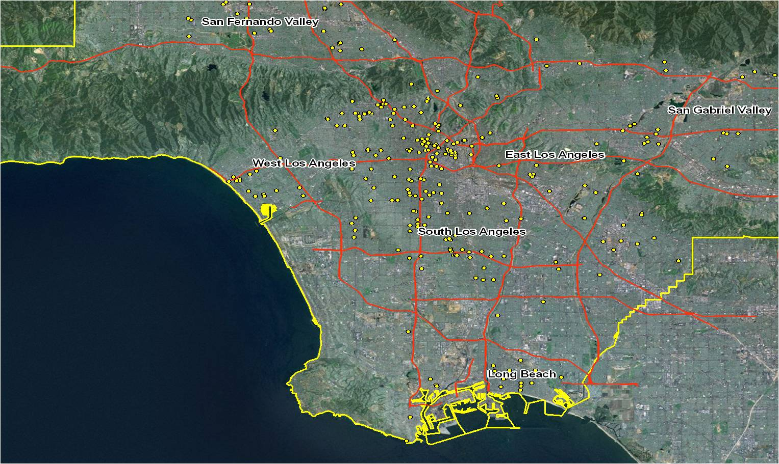
HIV Testing Sites in Los Angeles County
95% Black or Hispanic 1/3 live at or below poverty line Epidemic growing fastest here
Source: HIV Testing Services, 2009

Slide 10
Study Design
Clinic | Baseline |  | Intervention
 | Months -3 to 0 |  | Months 1 to 2 | Months 3 to 4 | Months 5 – 6
A | Physician risk-based |  | Physician Opt-Out | Nurse Opt-In | Nurse Opt-Out
B | Physician risk-based | Physician Opt-Out |  | Nurse Opt-Out | Nurse Opt-In
Eligibility: 18 – 64 years
Rapid HIV screening
Notes:
We used a quasi-experimental times samples study design. The rows represents the 2 clinics. In the baseline column, you can see that physician risk-based screening according to USPSTF recommendations was performed. This was followed by 2 months of physician initiated opt-out screening in both clinics, and the latter 4 months either Nurse opt-in or opt-out.
For the opt-in model, patients were exposed to a scripted verbal consent process that included a description of the risks and benefits of testing, followed by asking “Would you like to have an HIV test today?”
For the opt-out model, patients were informed that HIV screening is being offered to all patients, and then told, “We plan to do HIV testing for you today,…”
Each of these models were implemented within the routine flow of patient care in each clinic. Rapid point of care testing, which provides results in 20 minutes, were used. Physicians offered screening during the patient encounter while in the room. Nursing offered testing either before the patient saw the MD or while the patient was awaiting other nursing procedures.

Slide 11
Data & Analytic Methods
Data Collection
Medical record
  Accept vs. decline testing
  Demographic characteristics
  Previous HIV test in the last 6 months
  Study phase of testing
Data Analysis
Chi-square to assess differences in test offer and acceptance
Multivariate logistic regression to assess associations between acceptance of testing and phase of screening and other patient characteristics
Notes:
From the medical record, we collected data on whether the patient accepted or declined testing, patient demographics, whether the patient reported having a previous HIV test in the last 6 months.
We used chi-square test for assess differences in testing offers and patient acceptance between interventions
multivariate logistic regression to identify demographic correlates of screening refusal

Slide 12
Overall HIV Test Acceptance
Test Offered*
4,366
Clinic A
2,899 (66%)
Test Accepted
2,598 (60%)
Clinic B
1,467 (34%)
Clinic A
1,345 (46%)
Clinic B
1,253 (85%)
*HIV screening was offered in 25 to 35% of encounters with eligible patients

Slide 13
Demographic Characteristics of Clients Offered an HIV Test
Characteristic | Clinic A | Clinic B
Total N | 2,899 | 1,467
Female | 60% | 65%
Latino | 57% | 86%
African-American | 40% | 11%
< 30 years | 5% | 26%
31 – 49 years | 32% | 51%
50 – 64 years | 54% | 22%
> 65 years | 9% | 1%
Tested in last 6 mos. | 20% | 7%
Notes:
These data describe the patients who were offered HIV screening at both clinics. Over the baseline and intervention period, HIV screening was offered in 4366 patient encounters.
66% of the study sample was at Clinic A.
60 to 65% of the sample was female
There were considerably more latinos at Clinic B- 86% compared to 57% at Clinic A. And more African Americans at Clinic A 40% compared to 11% at Clinic B.
The patients at Clinic B were younger than Clinic A- -with almost 80% of the patients less than 49 years old. While at Clinic A, more than 60% of the patients were over the age of 50.
20% of patients reported having a test in the last 6 months at Clinic A, with 7% Clinic B.

Slide 14
Test Offer, Acceptance,
& Screening Rate by Phase
Testing Phase | Eligible N | % Offered | % Accepting | Screening Rate (%)
Risk-Based | 5,303 | 13% | 67% | 9%
MD-Opt-Out | 3,311 | 37% | 65% | 24%
RN Opt-Out | 4,321 | 27% | 54% | 15%
RN Opt-In | 3,815 | 33% | 56% | 19%
Notes:
This slide describes the percentage of eligible patients who were offered testing by phase, the % of patients accepting testing, and the overall testing rate.
In risk based screening, 11…
… In sum, MD Opt-out compared to the 2 other screening interventions had the highest offer, acceptance, and testing rates.
The p-value in the slide is associated with differences in acceptance rates between the routine opt-in/opt-out to the risk based

Slide 15
Multivariate logistic regression predicting test acceptance #
Model Variable^ | OR
Testing Phase (ref: RN Opt-In)
RN Opt-Out | 0.91
MD Opt-Out | 5.7*
Age (ref: < 30)
30 – 49 | 0.68*
50 – 64 | 0.56*
> 65 | 0.23*
Sex (ref: Male)
Female | 0.74*
Race (ref: Latino)
African American | 0.85*
Other | 1.22*
No HIV test in last 6 months | 10.4*
#N = 3,664
*p< 0.0001
^Model also adjusted for clinical site
Notes:
In multivariate logistic regression predicting test acceptance, there was no difference in test acceptance between RN opt-out screening compared to RN opt-in screening, adjusting for demographics, previous history of testing, and clinical site. As you can see, MD opt-out had a significantly higher odds of test acceptance. Increasing Age, female sex, and African American ethnicity were associated with decreased test acceptance. And of those not reporting a previous HIV test in the last 6 months, were much more likely to accept screening.

Slide 16
Conclusions
Routine HIV screening with either opt-in or opt-out resulted in at least a 2-fold increase in the percentage of patients offered and undergoing HIV testing compared to risk-based screening
In multivariate analysis, MD opt-out screening is associated with greater odds of test acceptance than RN opt-in or RN opt-out screening
Increasing age, female sex, and African-American ethnicity were associated with a lower multivariate odds of test acceptance

Slide 17
Limitations
Quasi-experimental rather than randomized design
  Interventions were fully integrated into clinic care
Potential variability in fidelity to interventions
  Patient survey data will help determine this
Uncertainty about percent eligible for screening at both clinics
  Current results may underestimate percent offered testing

Slide 18
Policy Implications
Opt-out HIV screening is feasible in community health centers, but does not ensure universal offering of HIV testing
  Offer and acceptance rates vary by clinic
  Strategies to improve offer rate are needed
If RN is offering HIV screening, it may be as effective to use the opt-in method as the opt-out method
  Avoid potential problem of coercion
Routine HIV screening may not sufficiently increase testing rates for some groups with high prevalence of undiagnosed HIV infection

Slide 19
For More Information
Jacqueline Rurangirwa, MPH
Epidemiologist
Office of AIDS Programs and Policy
County of Los Angeles Department of Public Health
E-mail: jrurangirwa@ph.lacounty.gov

