Slide 1
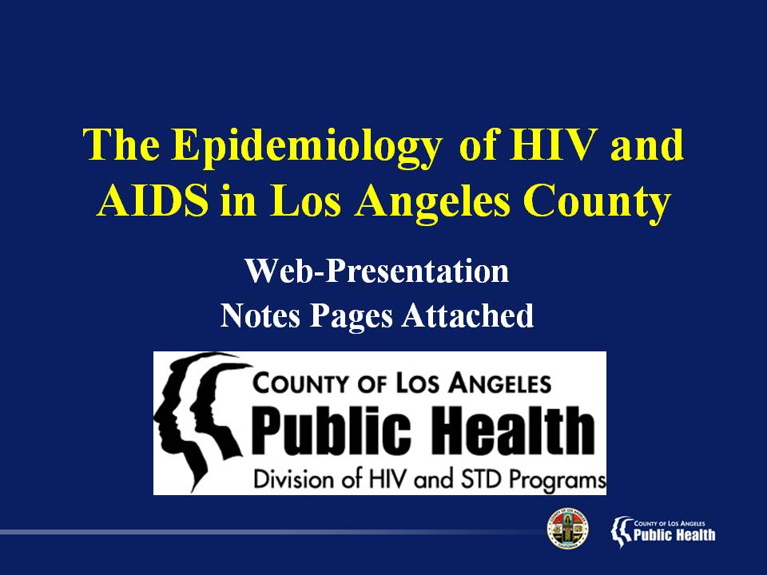
Notes:
This presentation is intended to provide a general overview of the epidemiology of Human Immunodeficiency Virus (HIV) and Acquired Immune Deficiency Syndrome (AIDS) in Los Angeles County (LAC).
Data are provided by the Division of HIV and STD Programs/ HIV Epidemiology located at 600 South Commonwealth Avenue, Suite 1920 Los Angeles, CA 90005.
Notes are provided for each slide, intending to provide a clear interpretation of the data presented on the slides.

Slide 2
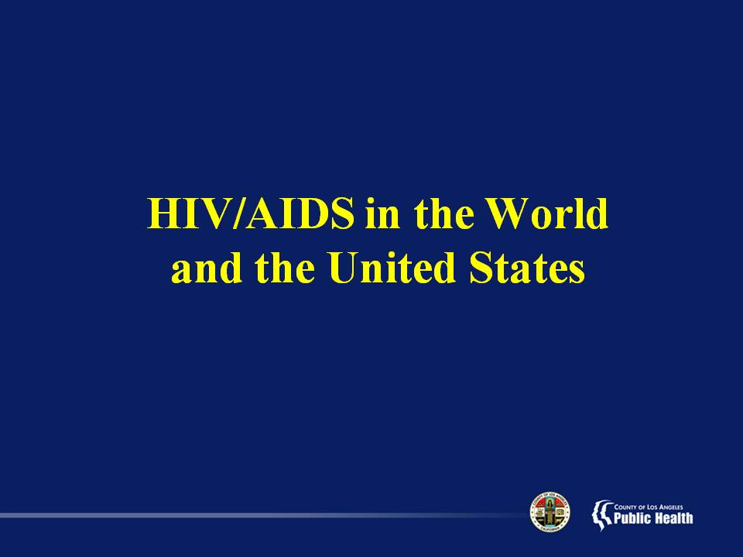
Notes:
The HIV/AIDS pandemic is a widespread disease that affects all parts of the globe. These first few slides are intended to put the local epidemic into a national and worldwide context.
It is important to note that the HIV/AIDS epidemic in the U.S. is not uniform. The demographics and risk exposures of those affected by HIV/AIDS in the U.S. varies greatly depending upon region--from high injection drug users in the Northeast cities to blacks in the rural South to men who have sex with men in the West.
So applying national statistics to localized communities is likely to lead to a misrepresentation of the local epidemic. Therefore, when referencing HIV/AIDS data to describe local groups impacted by HIV/AIDS, be sure to reference local data.

Slide 3
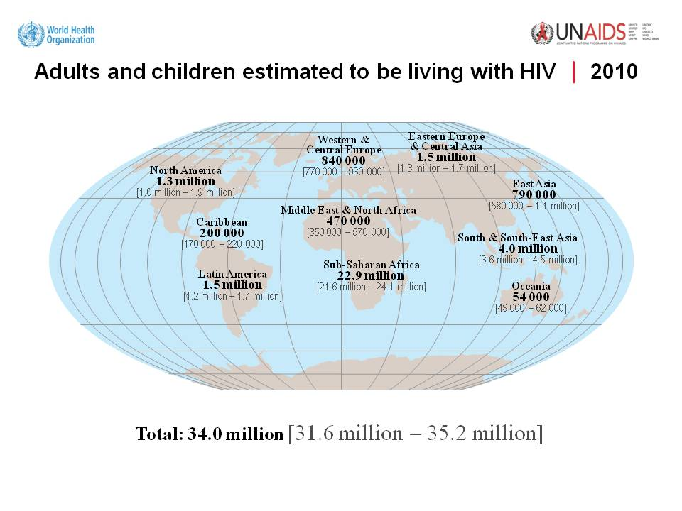
Notes:
This slide shows the estimated number of people living with HIV by region of the World.
Globally, the AIDS pandemic has affected sub-Saharan Africa the greatest with an estimated 22.9 million people living with HIV. As the reporting of HIV infection in Asian nations begins to gain momentum, higher numbers are expected from these regions as well. North America and Latin America have over one million people affected.

Slide 4
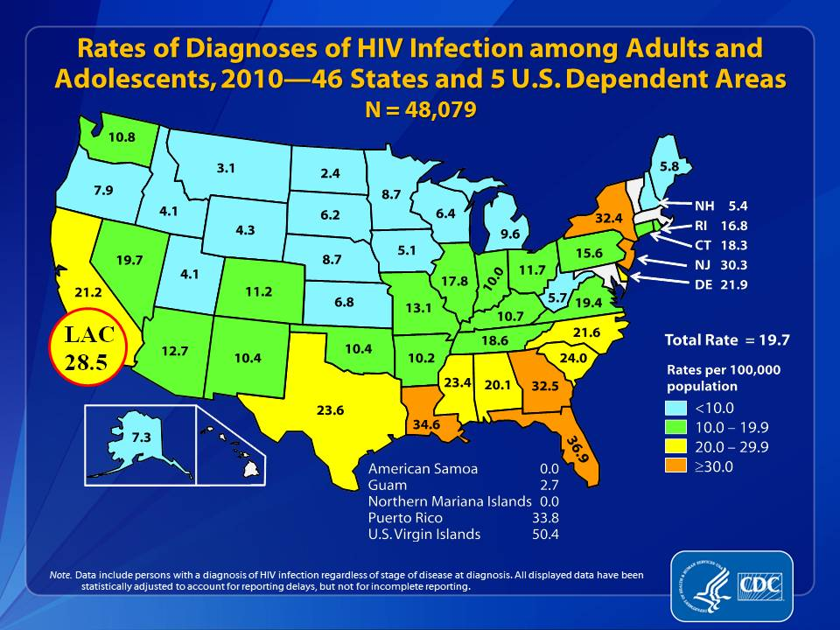
Notes:
This slide from the Centers for Disease Control shows the estimated rate of new HIV infection diagnoses in 2010 for each state as the number of reported HIV cases per 100,000 persons in that state.
States with the highest rates (equal to or greater than 30.0 per 100,000) are shown in orange, those with moderate rates in green (10.0 per 100,000 to 19.9 per 100,000) and yellow (20.0 per 100,000 to 29.9 per 100,000), and states with the lowest rates (less than 10.0 per 100,000) in blue.
At the end of 2010, Florida had the highest diagnosis rate of HIV infection with 36.9 cases per 100,000, while North Dakota had the lowest rate with 2.4 cases per 100,000. The diagnosis rate of HIV infection reported for 2010 in Los Angeles County (28.5 per 100,000) is higher to that in California as a whole (21.2 per 100,000). Please note that the rate for LAC given in this slide is estimated by CDC, and may be slightly different from our estimate.

Slide 5
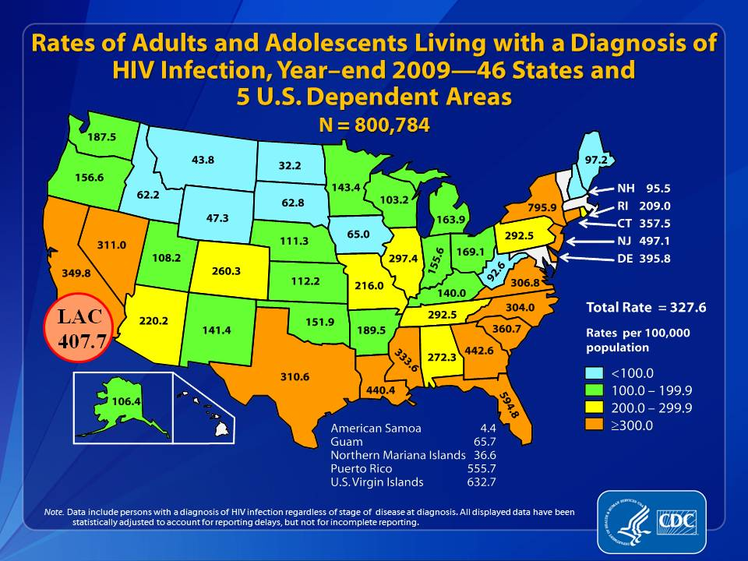
Notes:
This slide from the Centers for Disease Control shows the estimated rate of adults and adolescents living with a diagnosis of HIV infection at the end of 2009 in each state expressed in number of people living with HIV infection per 100,000 persons.
States with the highest rates (equal to or greater than 300.0 per 100,000) are shown in orange, those with moderate rates in green (100.0 per 100,000 to 199.9 per 100,000) and yellow (200.0 per 100,000 to 299.9 per 100,000), and states with the lowest rates (less than 100.0 per 100,000) in blue.
At the end of 2009, New York had the highest rate of people living with HIV infection (795.9 cases per 100,000), and North Dakota had the lowest rate (32.2 cases per 100,000). The rate of people living with a diagnosis of HIV infection in 2009 for Los Angeles County is (407.7 per 100,000) much greater than that for California as a whole (349.8 per 100,000). Please note that the rate for LAC given in this slide is estimated by CDC, and may be slightly different from our estimate.

Slide 6
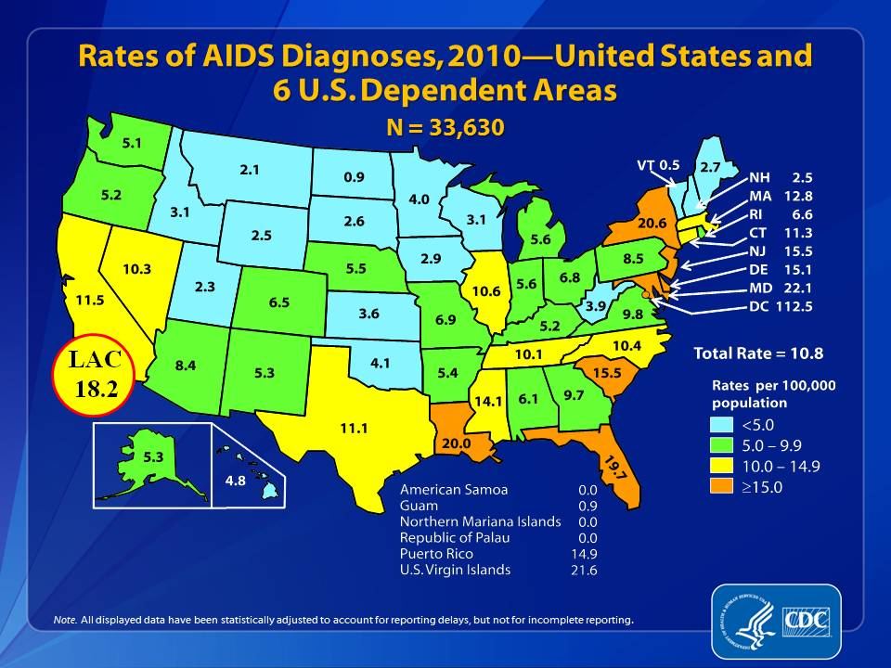
Notes:
In this slide from the Centers for Disease Control, the estimated rate of new AIDS diagnoses in 2010 for each state is expressed as the number of reported AIDS cases per 100,000 persons in that state.
States with the highest rates (equal to or greater than 15.0 per 100,000) are shown in orange, those with moderate rates in green (5.0 per 100,000 to 9.9 per 100,000) and yellow (10.0 per 100,000 to 14.9 per 100,000), and states with the lowest rates (less than 5.0 per 100,000) in blue.
In the United States, the District of Columbia is the area that has been most impacted, with 112.5 cases per 100,000, while Vermont is the area with the lowest rate, with 0.5 cases per 100,000. Notice that the rate of AIDS cases reported in 2010 for Los Angeles County (18.2 per 100,000) is higher than that for California as a whole (11.5 per 100,000). Please note that the rate for LAC given in this slide is estimated by CDC, and may be slightly different from our estimate.

Slide 7
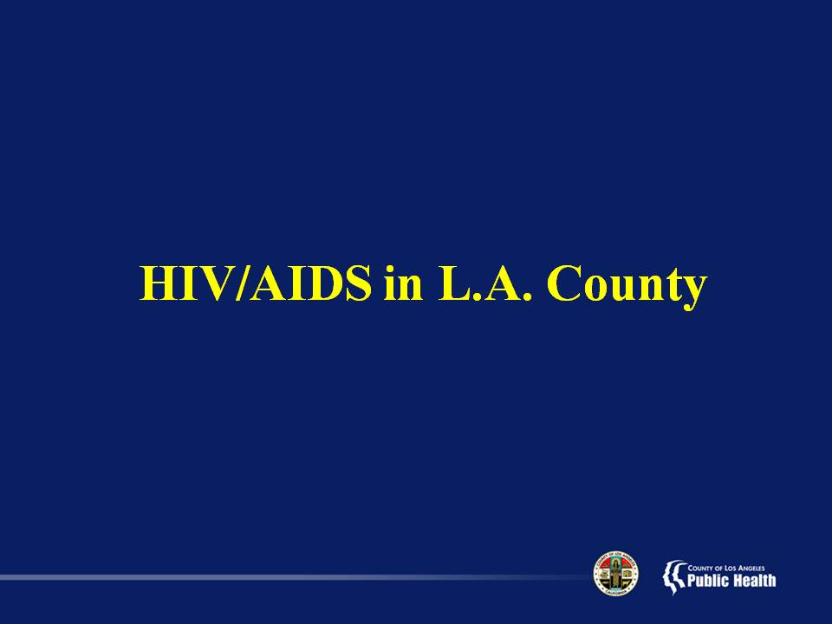

Slide 8
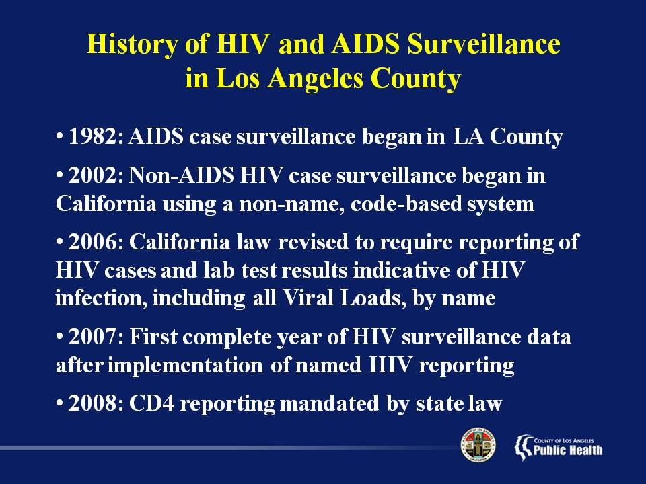

Slide 9
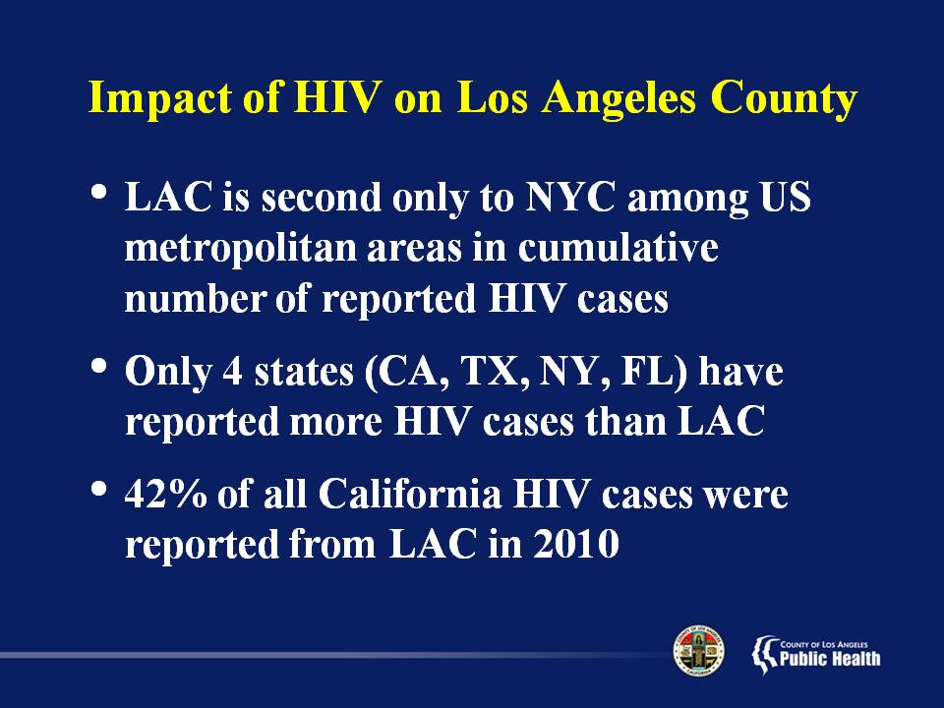

Slide 10
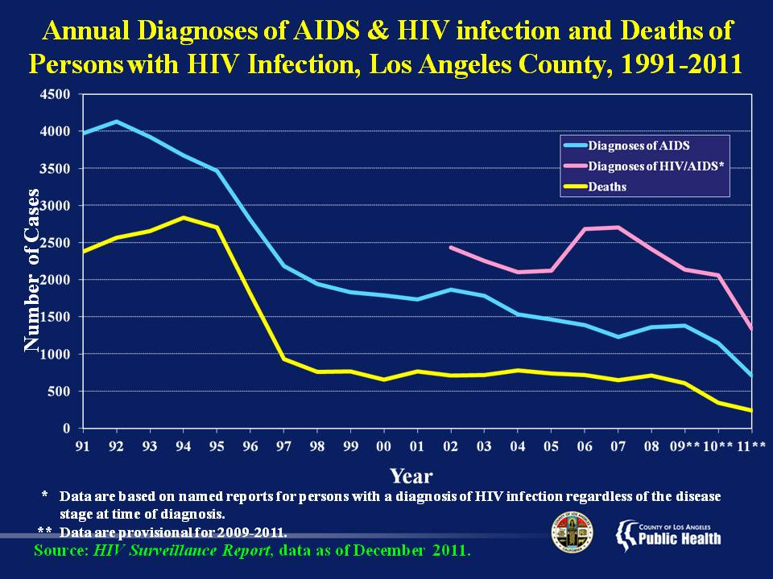
Notes:
This slide shows the trends comparing annual HIV/AIDS diagnoses, AIDS diagnoses, and deaths of persons with HIV infection (regardless of severity of disease) from 1991-2011.
Annual AIDS diagnoses, depicted by the blue line, have been steadily decreasing since 1992. A slight increase in the number of new AIDS diagnoses in 2002 and 2008 may be attributed to the implementation of code-based HIV reporting in July 2002 and the reporting of CD4 T-cell count in September 2008, respectively.
Deaths from HIV/AIDS, depicted by the yellow line, decreased substantially after 1995, and has been relatively stable since 1998. This sudden decrease is most likely due to the introduction of the drug regimen known as “highly active antiretroviral therapy” or HAART.
Diagnoses of HIV/AIDS are depicted by the pink line.
In California, coded HIV reporting began in July 2002 and named HIV reporting began in April 2006. During the first few years of HIV reporting, many HIV cases (persons who had been diagnosed with HIV prior to 2006) were likely misclassified as a new HIV diagnosis in recent years (especially 2006-2008), since a complete patient history on HIV might not have been available to the persons who completed the case report forms. Therefore, the “bump” in the number of reported cases seen for years 2006-2008 could likely be caused by the change in reporting regulations and should not be interpreted as the real increase in newly diagnosed HIV disease.
Therefore, the data can not be used to draw conclusions on the trends for non-AIDS HIV or HIV/AIDS combined.

Slide 11
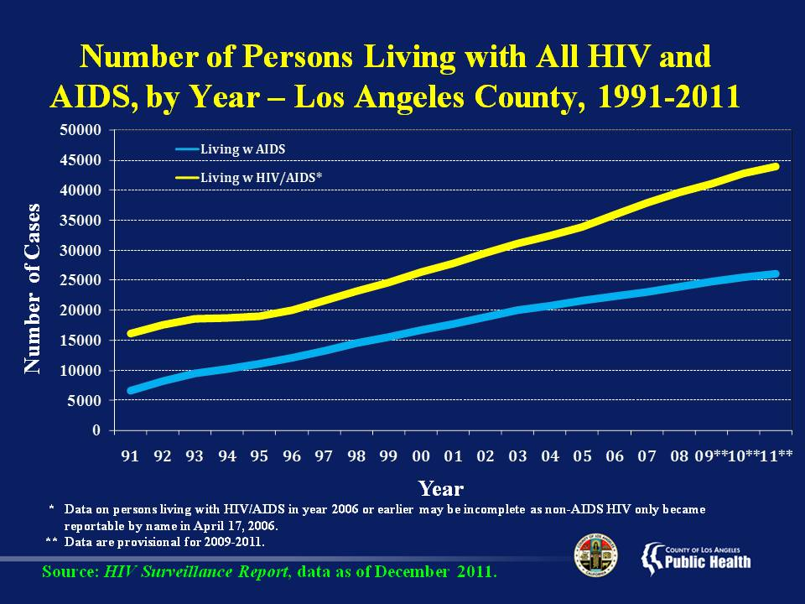
Notes:
This slide shows the trend of the number of persons living with HIV and AIDS by year in Los Angeles County, from 1991-2011.
The number of persons living with HIV/AIDS combined and AIDS alone, depicted by the yellow and blue lines, respectively, has grown steadily since 1991.
Although there is a widening gap between the two since 1995, it may be an artifact due to HIV reporting not in place in California before 2002 and that some newly reported persons of HIV may have been misclassified as recent diagnoses.
Due to reporting delays and the fact that the data are not yet mature, it is too early to draw conclusions on the trends seen in 2009-2011.

Slide 12
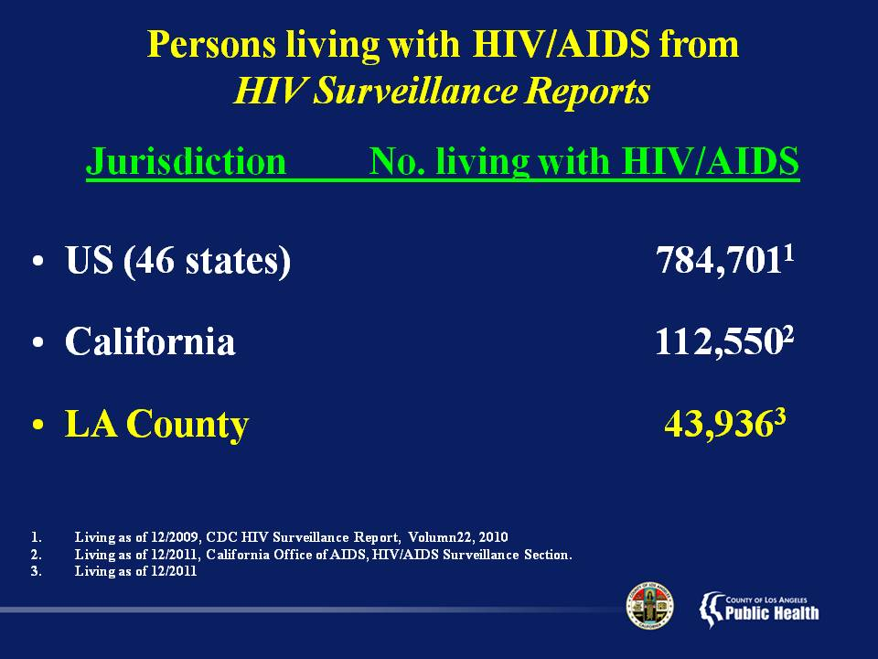
Notes:
This slide shows the number of persons living with HIV/AIDS, regardless of severity of disease, in the U.S. (46 states), California, and Los Angeles County.
In the U.S., estimated 784,701 persons were living with HIV infection as of 2009 in 46 states with Mature HIV Infection Reporting Systems.
California, with 112,550 persons living with HIV/AIDS as of December 2011, represents 14% of persons living with HIV/AIDS in the US. Los Angeles County, with 43,936 persons as of 2011, represents 39% of persons living with HIV/AIDS in California.

Slide 13
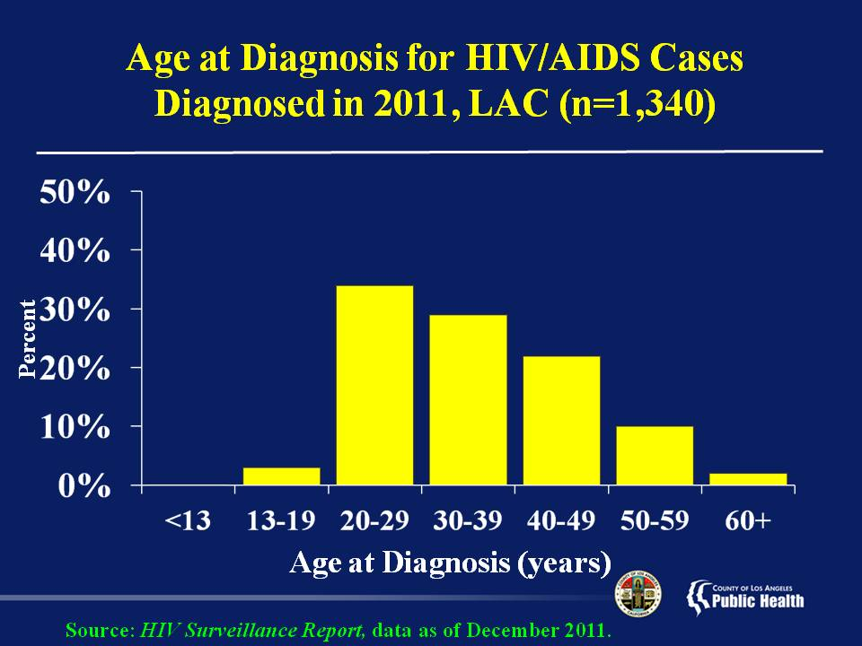
Notes:
This slide shows the age distribution of new HIV/AIDS diagnosis in 2011, reported by December 31, 2011.
Less than one percent of cases were diagnosed with HIV/AIDS before age 13 (pediatric HIV/AIDS cases). Three percent of cases were diagnosed between the ages of 13 and 19. The age group with the highest percentage of new HIV/AIDS diagnosis was between 20 and 29 years of age (34%). Twenty-nine percent, 22%, and 10% were diagnosed between 30-39 years old, 40-49 years old, and 50-59 years old, respectively. The remaining 2% of cases were diagnosed among 60 years old or older.
The age group heavily affected by a new HIV/AIDS diagnosis is between 20 and 49 years of age.

Slide 14
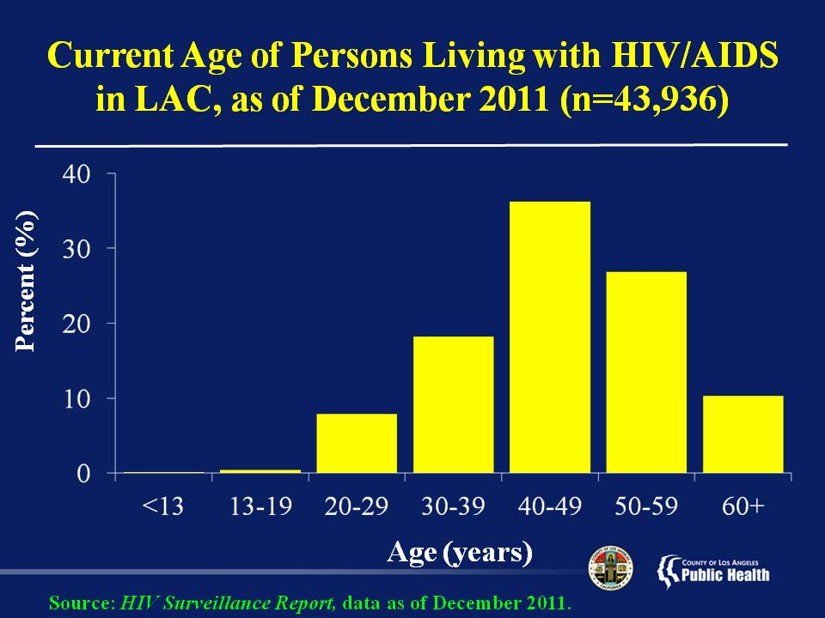
Notes:
This slide shows the current age of persons living with HIV/AIDS in Los Angeles County as of December 2011.
The largest proportion of persons living with HIV/AIDS is among the 40 to 49 year-olds with 36%, followed by the 50 to 59 year-olds (27%), 30 to 39 year-olds (18%), 60 and over (10%), and 20 to 29 year olds (8%). The less-than-13 and the 13-to-19 age groups combined make up less than 1% of persons living with HIV/AIDS.
The fact that almost three-fourths of all persons living with HIV/AIDS in LAC are age 40 and over has implications for HIV care and treatment planning--especially with regard to combining care for HIV with care for other conditions associated with aging.

Slide 15
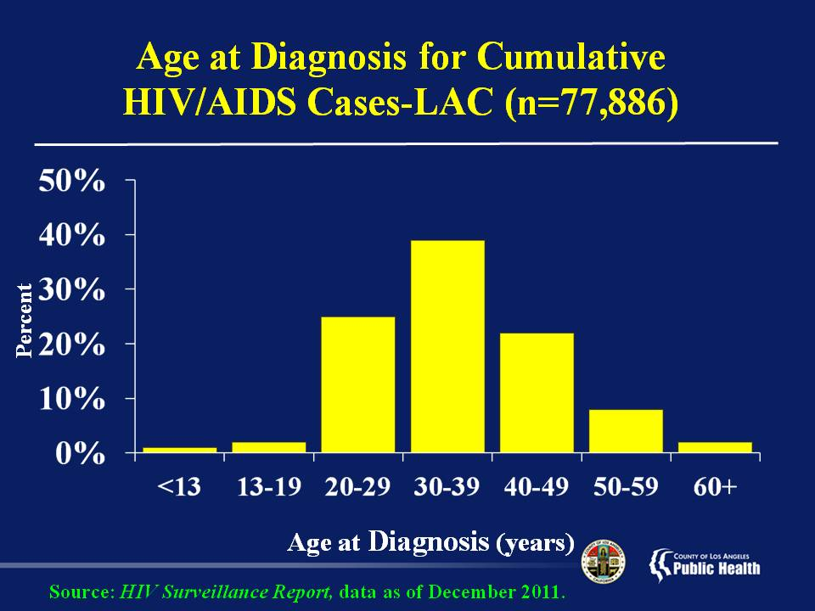
Notes:
This slide shows the age at diagnosis for all cumulative cases of HIV infection that have been reported since the beginning of the epidemic (1981) through December 2011 in Los Angeles County .
The largest proportion of cumulative HIV/AIDS is among the 30 to 39 year-olds with 39%, followed by the 20 to 29 year-olds (25%), 40 to 49 year-olds (22%), 50 to 59 year- olds (8%), 13-19 year-olds (2%), and 60 over (2%). One percent of cases were diagnosed with HIV infection before age 13 (pediatric AIDS cases).

Slide 16
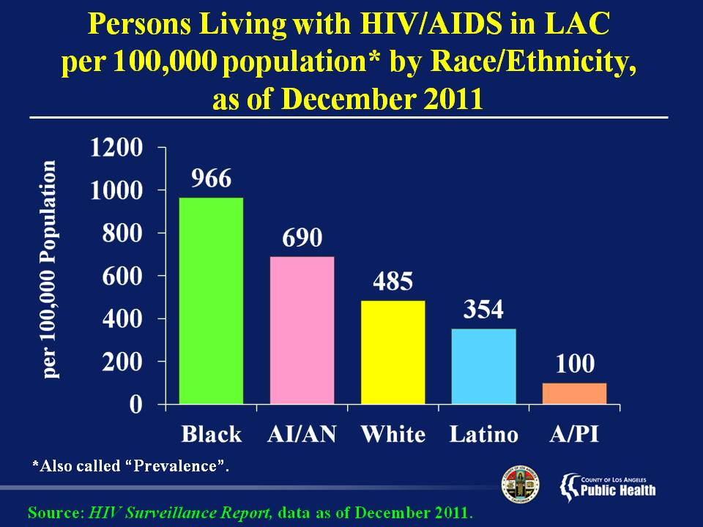
Notes:
This slide shows the prevalence of persons living with HIV/AIDS at the end of 2011 by race/ethnicity, expressed as a “rate” in cases per 100,000 population.
Prevalence is defined as the total number of cases in the population at a given time, or the total number of cases in the population, divided by the number of individuals in the population. It is used as an estimate of how common a disease is within a population over a certain period of time.
Prevalence=a/(a+b)
Remember, a rate measures the impact of a disease in a given area because it takes into account the size of each population. Therefore, although far more Whites and Latinos are living with HIV/AIDS in Los Angeles County, Blacks who represent less than 10 percent of the general population in this county has been most impacted with the highest prevalence rate at 966 per 100,000, nearly twice the rate of Whites and almost three times that of Latinos.
And American Indians/Alaskan Natives, while comprising a very small percentage of the population, have the second highest rate of persons living with HIV/AIDS at 690 per 100,000.

Slide 17
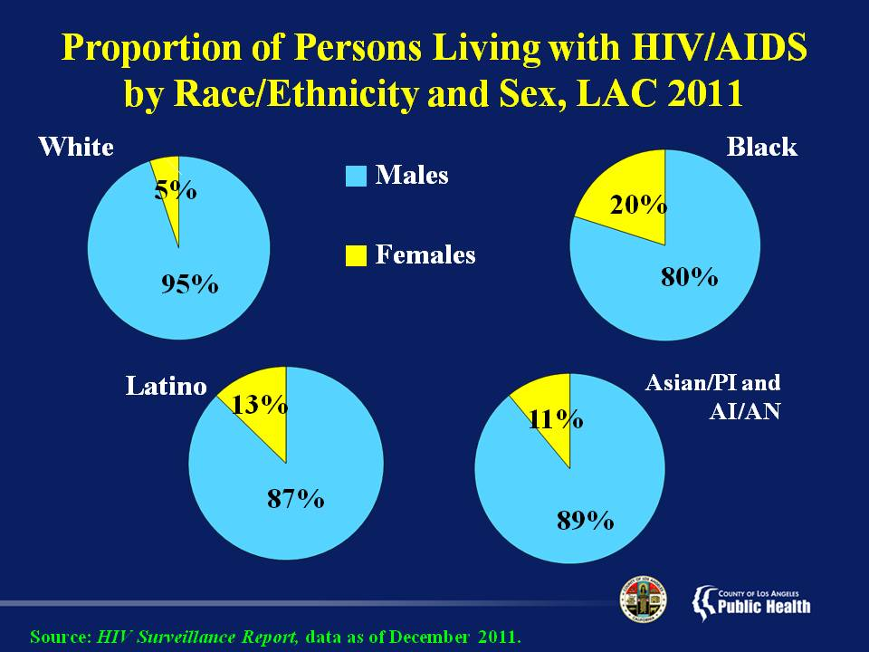
Notes:
This slide shows the proportion of males and females living with HIV/AIDS by race/ethnicity in LA County in 2011.
Whites have the greatest proportion of males living with HIV/AIDS (95%), and the smallest proportion of females affected (5%). Blacks have the greatest proportion of females affected (20%), and the smallest proportion of males affected (80%).
Latinos and ‘Other’ races (Asian/Pacific Islander and American Indian/Alaska Native combined) have similar proportions of males and females affected. 87% of Latinos living with HIV/AIDS are men and 13% are women. 89% of Asian/Pacific Islanders and American Indian/Alaska Natives living with HIV/AIDS are men, and 11% are women.

Slide 18
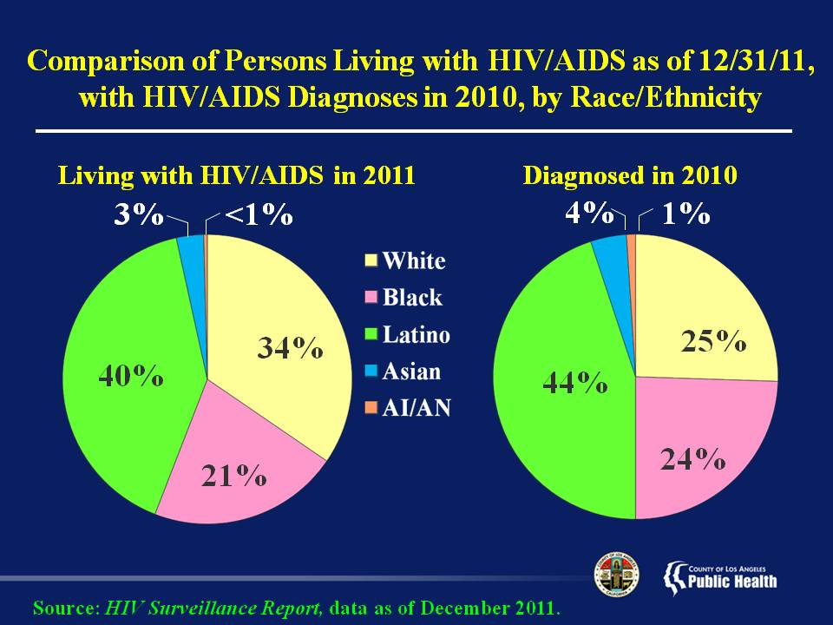
Notes:
This slide shows the comparison of the distribution of persons living with HIV/AIDS by December 31, 2011, and HIV/AIDS diagnoses in 2010 in Los Angeles County by race/ethnicity.
Among persons living with HIV/AIDS as of 2011, 40% are Latino, 34% White, 21% Black, 3% Asian, and less than 1% are American Indian/Alaska Native. HIV/AIDS cases diagnosed in 2010 follow a similar trend in which Latinos consist of the largest proportion of cases, and American Indian/Alaska Natives have the smallest proportion of cases. In 2010, Latinos accounted for 44% of the diagnosed cases followed by Whites 25%, Blacks 24%, Asians 4% and American Indian/Alaska Natives with 1%.
In summary, persons of color represent a larger proportion among the new HIV/AIDS diagnoses when compared to the proportions among persons living with HIV/AIDS.

Slide 19
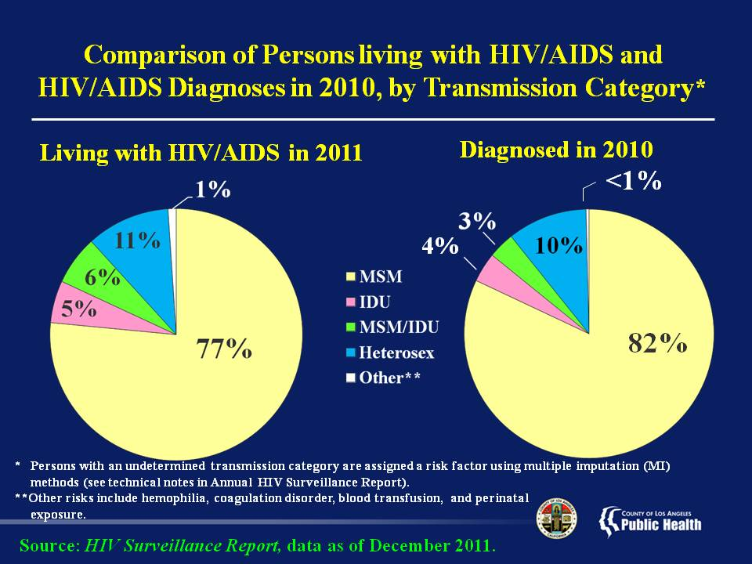
Notes:
This slide shows the comparison of the distribution of persons living with HIV/AIDS through the end of 2011 and cases diagnosed in 2010 in Los Angeles County by transmission category.
Among persons living with HIV/AIDS at the end of 2011, 77% are Men Who Have Sex with Men (MSM), compared with 6% who are MSM that also inject illicit drugs, 5% who are other injection drug users (IDU), 11% whose transmission category is heterosexual contact, and 1% whose transmission results from hemophilia, blood transfusion, and from perinatal transmission--that is, from an HIV-infected mother.
For persons diagnosed with HIV/AIDS in 2010, 82% are MSM, compared with 3% who are MSM that also inject illicit drugs, 4% who are other injection drug users, 10% whose transmission category is heterosexual contact, and less than 1% whose transmission results from hemophilia, blood transfusion, and from perinatal transmission.
Since the distribution of transmission categories in the new cases diagnosed in 2010 approximates those living with HIV/AIDS, shows that the risk factors for transmission remain the same.
Please note that persons without an identified risk factor were assigned a risk factor based on multiple imputation (MI) methods (see technical notes in HIV/AIDS Surveillance Summary).

Slide 20
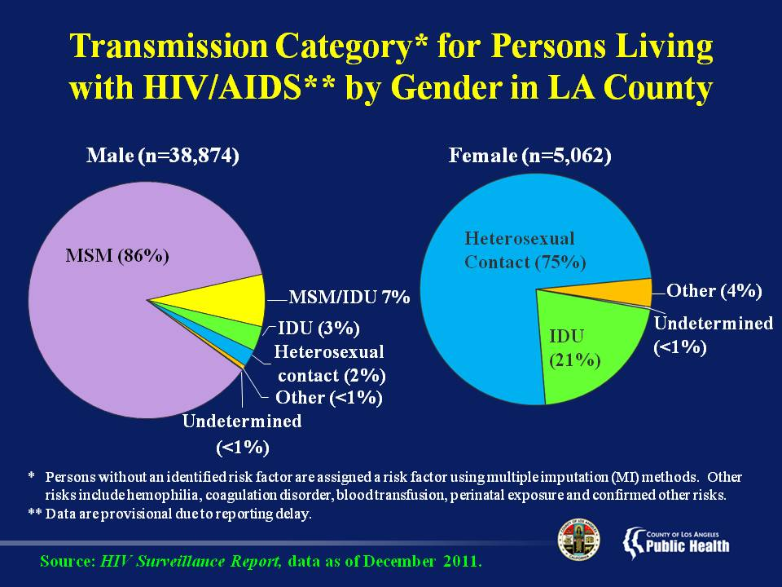
Notes:
This slide shows the transmission category of HIV exposure for persons living with HIV/AIDS in Los Angeles County as of December 2011 by gender. These data are statistically redistributed using methods modified from the CDC to assign a transmission category to persons in which a transmission category was undetermined.
Among men living with HIV/AIDS as of December 2011, 86% were Men Who Have Sex with Men (MSM), compared with 7% who were MSM that also inject illicit drugs, 3% who were other male injection drug users, 2% whose transmission category was heterosexual contact, and less than 1% with an undetermined transmission category. About 0.6% of transmission for men result from hemophilia, transfusion, and from perinatal transmission--that is, from an HIV-infected mother.
For females, 75% were women whose mode of transmission was through sexual contact with a man, compared with 21% who injected illicit drugs, and 4% who contracted the HIV through blood products (hemophilia/transfusion) and perinatal transmission. Less than 1% of females had an undetermined transmission category.

Slide 21
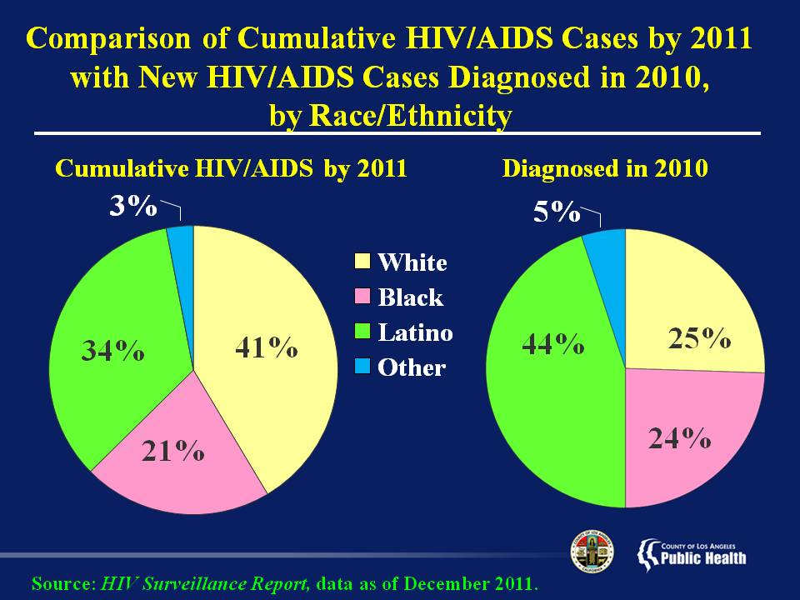
Notes:
This slide shows the distribution of cumulative HIV/AIDS cases by the end of 2011 and incident cases diagnosed in 2010 by race/ethnicity in Los Angeles County, providing another graphic depiction of the progressive shift in HIV/AIDS cases from Whites to persons of color.
Whites, shown in yellow, have proportionately fewer incident cases in 2010, compared with their share of cumulative cases. Meanwhile, Latinos, shown in green, and Blacks, shown in pink, have a higher proportion of incident cases, when compared to their share of cumulative cases.

Slide 22
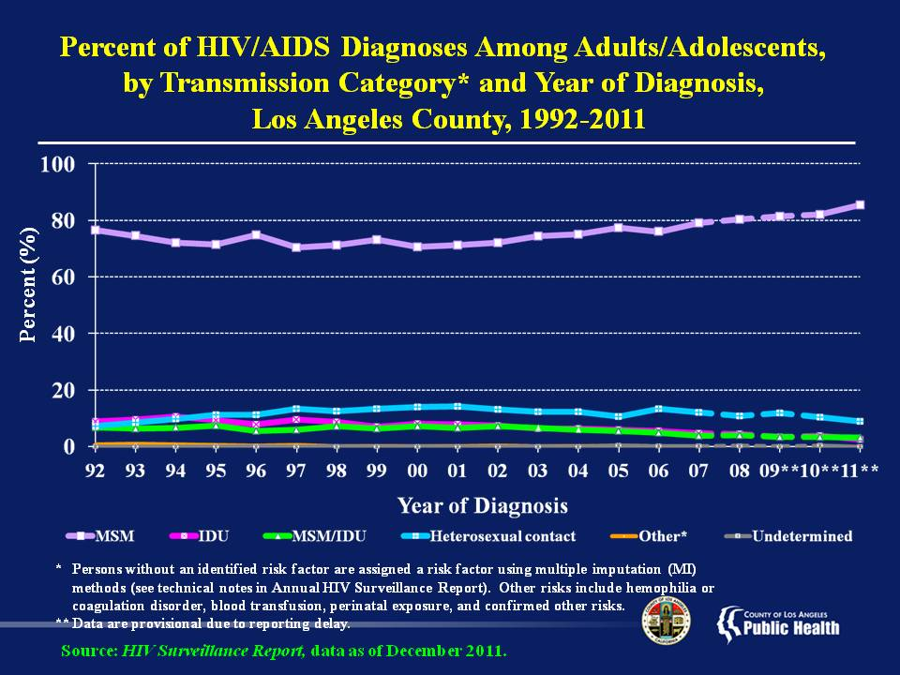
Notes:
This slide shows the proportion of HIV/AIDS diagnoses in adults and adolescents in Los Angeles County from 1992 through 2011 by transmission category.
The largest proportion of new diagnoses of HIV/AIDS in 2011 were among Men Who Have Sex With Men (MSM) at 85%, followed by heterosexual contact at 9%, Injection Drug Use (IDU) at 3%, MSM/IDU at 3%, and Other and Undetermined at less than 1%.
From 1992 to 2002 the proportion of HIV/AIDS diagnoses among (MSM) decreased slightly, but has since begun rising steadily. During the years that transmission of HIV by MSM decreased, there was a slight rise in transmission by heterosexual contact which has remained stable until recently.
Due to reporting delays and the fact that the data are not yet mature, it is too early to draw conclusions on the trends seen in 2009-2011.
Please note that persons with an undetermined transmission category were assigned a risk factor based on multiple imputation (MI) methods (see technical notes in Annual HIV Surveillance Report).

Slide 23
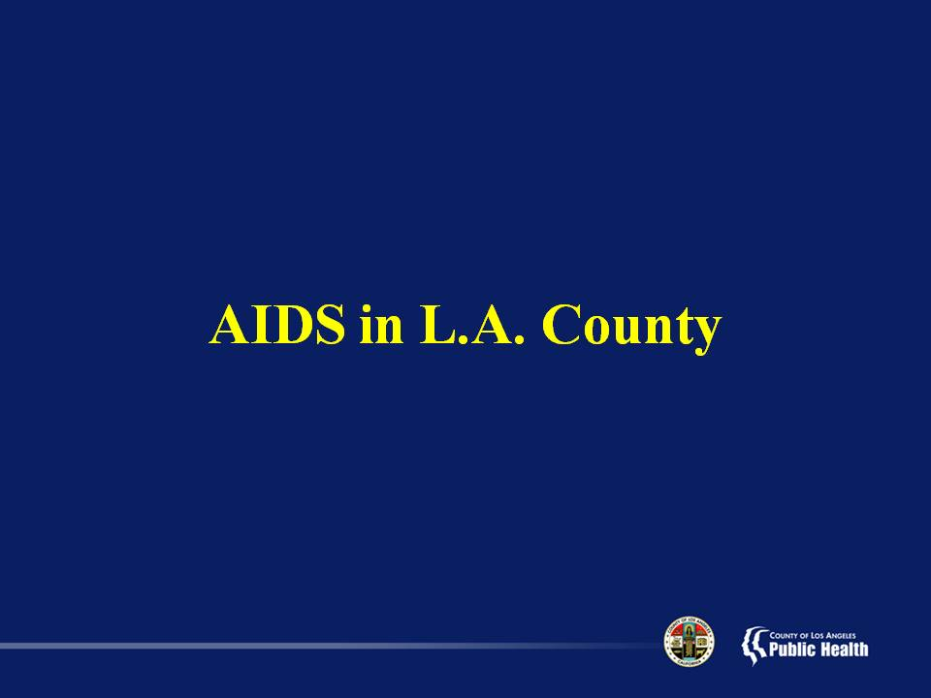

Slide 24
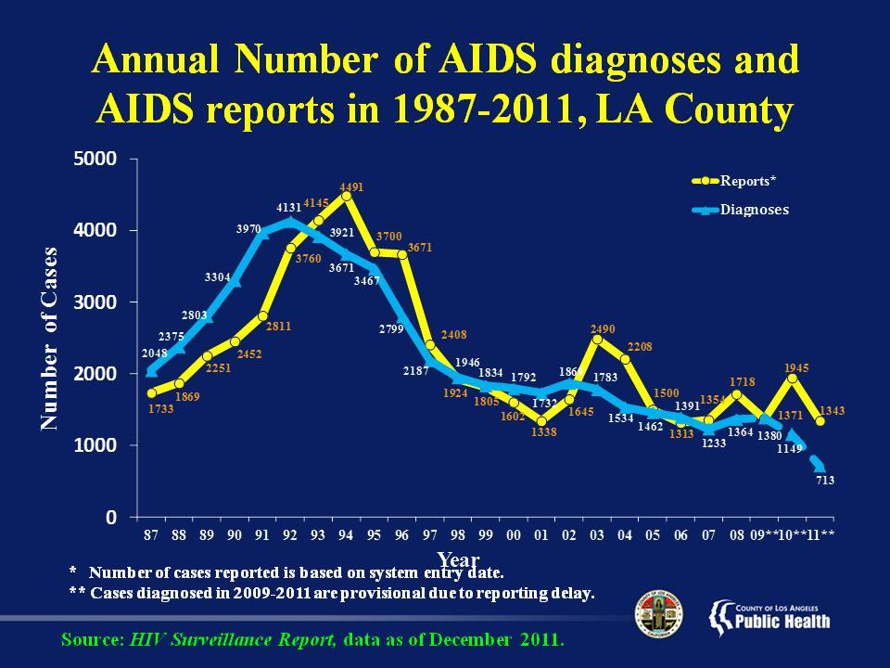
Notes:
This slide shows the annual number of AIDS diagnoses and AIDS reports in LA County from 1987-2011.
The greatest number of AIDS diagnoses and reports occurred from the beginning of the epidemic until about 1997, when effective HIV treatment became widely available.
The annual number of AIDS diagnoses in LA County has decreased substantially from a high of approximately 4,131 cases in 1992 to 1,233 cases in 2007.
The large increase in AIDS reported (but not necessarily diagnosed) in 2008 and 2010 were due to a change in the 2008 law that required laboratories to report all CD4+ T-cell lymphocyte counts. AIDS is diagnosed in persons with a CD4 count less than 200 or CD4 percent less than 14.
Please note that cases diagnosed in 2009-2011 are provisional due to reporting delay.

Slide 25
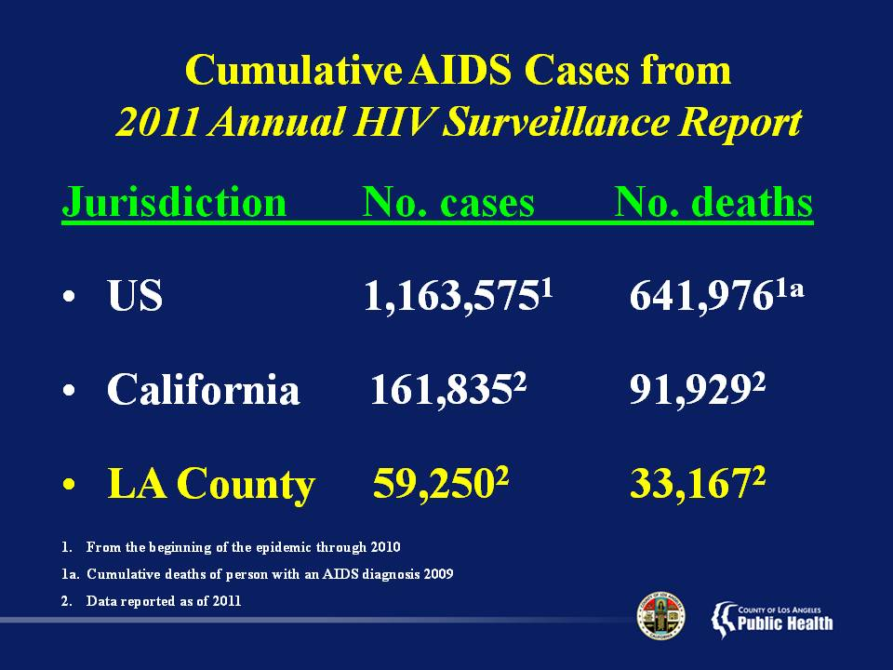
Notes:
This slide shows the cumulative number of cases of AIDS nationally, in California, and in Los Angeles County.
As of December 2010, there were 1,163,575 cases of AIDS reported in the U.S. As of December 2011, California reported 161,835 cases, accounting for 14% of AIDS cases nationally.
Los Angeles County at 59,250 cases of AIDS accounts for 5% of all AIDS cases reported in the US.
As of December 2009, it is estimated that 641,976 (55%) of all US AIDS cases have died. As of December 2011, California reported 91,929 (57%) persons with AIDS who have died, while in Los Angeles County, 33,167 (56%) persons have died.

Slide 26
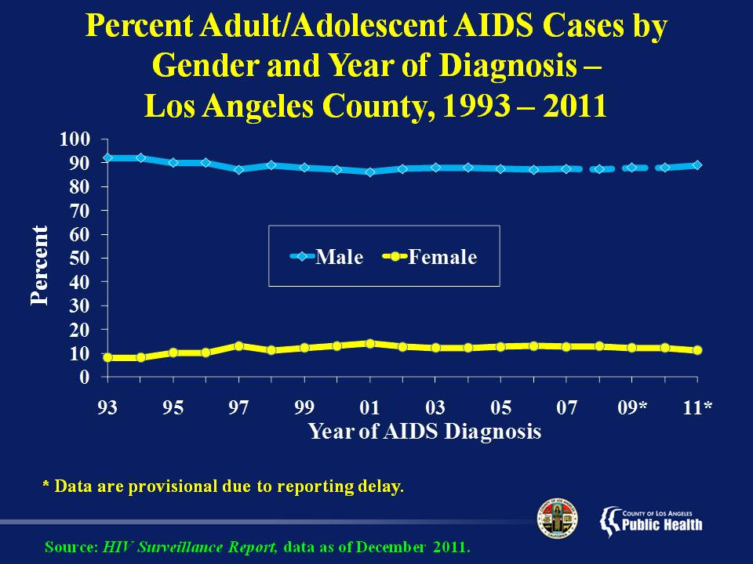
Notes:
This slide shows the proportion of Adult/Adolescent AIDS cases in Los Angeles County from 1993 through 2011 by gender.
Since the AIDS epidemic began, the largest proportion of diagnosed AIDS cases has been in the male population. In the mid 90s, males accounted for approximately 90% of all county AIDS cases and females constituted the remaining 10%. The percent of females with AIDS diagnosis has been slowly increasing, reaching its peak at 14% in 2001 from 8% in 1993.
Due to reporting delays, it is too early to draw conclusions on the trends seen in 2009-2011.

Slide 27
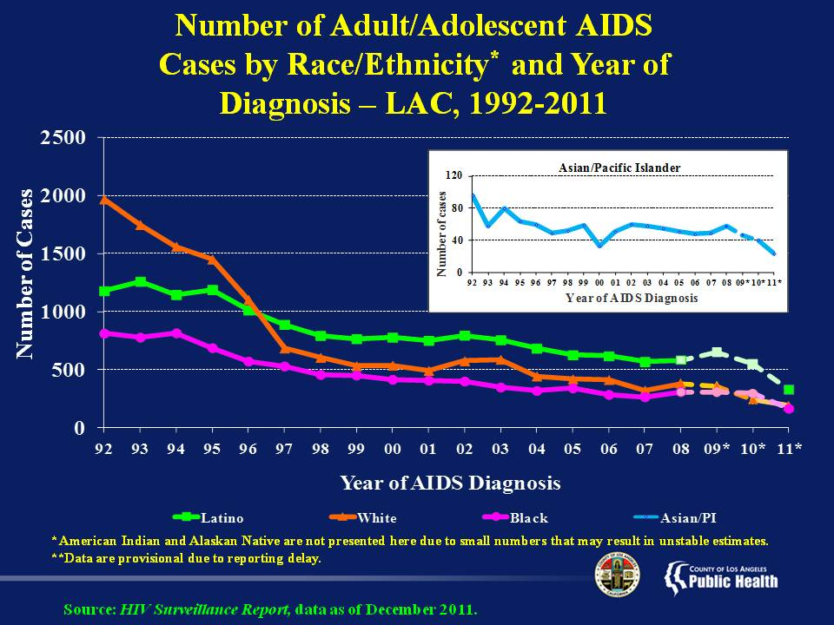
Notes:
This slide shows the annual number of adult and adolescent AIDS cases in Los Angeles County by race/ethnicity and year of diagnosis from 1992 through 2011. This slide combines both male and female cases.
Annual AIDS cases among Whites decreased by 82% from 1992 to 2009 (from 1971 cases to 358 cases), followed by Blacks (63% decrease from 814 to 304), Asian/Pacific Islanders (51% decrease from 96 to 47), and Latinos (45% decrease from 1180 to 648).
Please note that there are far fewer Asian/Pacific Islander cases of AIDS so a separate graph has been inserted using a scale from 0 to 120 to show the appropriate trend.
Due to reporting delays, it is too early to draw conclusions on the trends seen in 2009-2011.

Slide 28
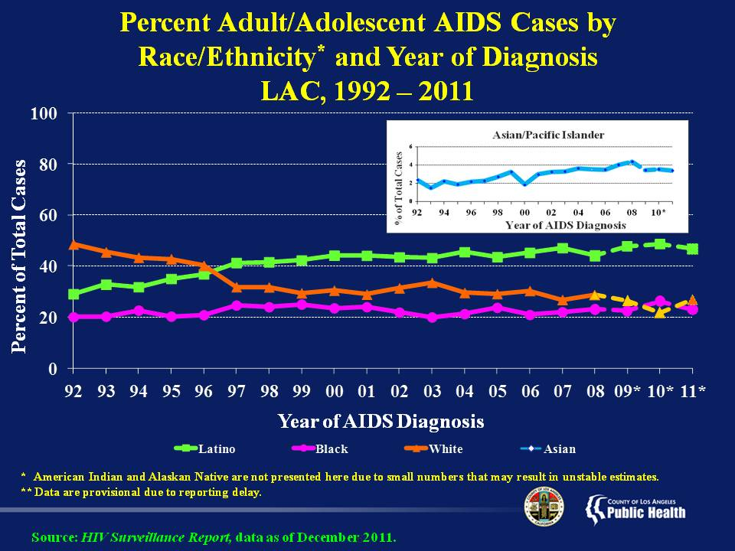
Notes:
This slide shows the proportion of adult and adolescent AIDS cases in Los Angeles County from 1992 through 2011 by race/ethnicity.
In 1992, the largest proportion of AIDS cases diagnosed in that year was among Whites at 49% compared to Latinos at 29%, Blacks at 20%, and Asians/Pacific Islanders at 2%.
Over time, there has been a substantial decrease in the proportion of cases among Whites and a substantial increase in the proportion of cases among Latinos, with Latinos accounting for the biggest proportion of cases since 1997.
In 2011, Latinos accounted for 47% of county AIDS reports, Whites 27%, Blacks 23%, and Asians/Pacific Islanders 3%.
Due to reporting delays, it is too early to draw conclusions on the trends seen in 2009-2011.

Slide 29
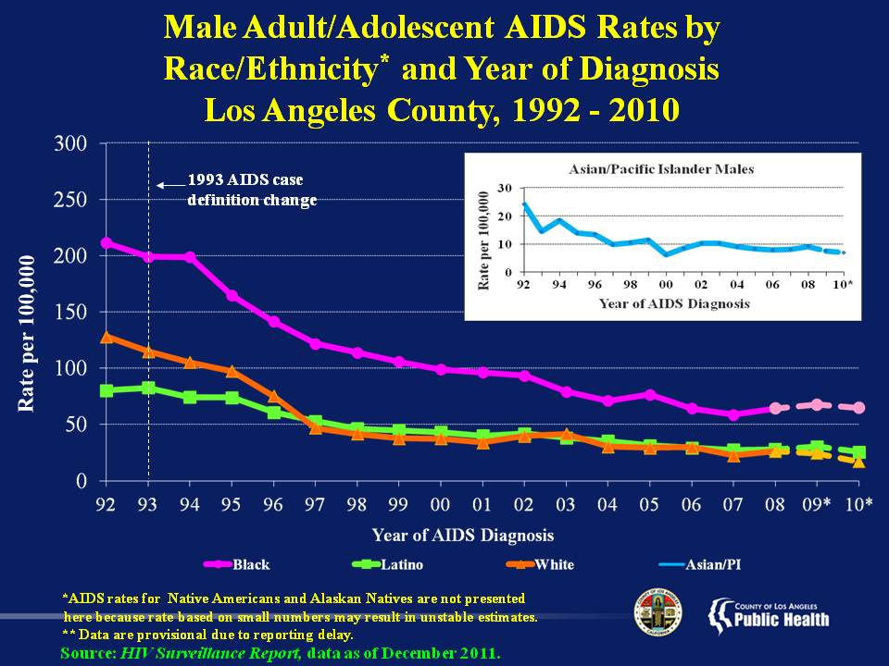
Notes:
This slide shows the annual AIDS rates for male Angelenos by race/ethnicity and year of diagnosis from 1992 through 2010.
Due to small number of cases, rates for American Indians and Alaskan Natives are considered unreliable and unstable, so are not presented here.
Since 1992, AIDS rates among Latinos, Blacks, and Whites have been decreasing. The greatest decrease is observed between 1994 and 1997 in all three groups. While the rates among Asians/Pacific Islanders show moderate fluctuations, the overall trend is decreasing.
The slight increase observed in Whites and Asian/Pacific Islander AIDS diagnoses in 2002 may simply be an artifact of the improvement in AIDS reporting that accompanied the implementation of laboratory-based HIV reporting in July of that year. Rates begin to decline after 2003 for Latinos, Whites, and Asian/Pacific Islander men.
During the period shown, AIDS rates among Blacks have been considerably higher than AIDS rates among Latinos and Whites. From 2006 to 2010, where the rates have been more or less stable, the average AIDS rate among Blacks (64 per 100,000) is over 2.5 times that of Whites (24 per 100,000) and over twice that of Latinos (28 per 100,000). However, the rate difference between Blacks and other ethnic groups has noticeably decreased over the years. Since 2004 the rate for Asian/Pacific Islander men has remained below 10 per 100,000 population.
Due to reporting delays, it is too early to draw conclusions on the trends seen in 2009-2010.

Slide 30
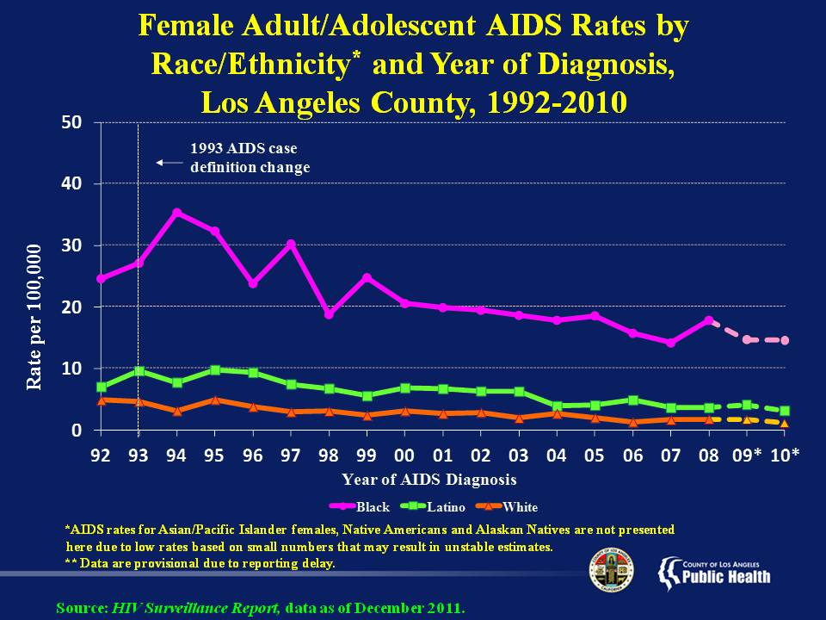
Notes:
This slide shows the annual AIDS rates for female Angelenos by race/ethnicity and year of diagnosis from 1992 through 2010. First, please note that there are far fewer female cases of AIDS than male cases, so the scale on the left hand side of the graph ranges from 0 to 50 compared to the scale for males on an earlier slide which ranged from 0 to 300.
Due to small numbers of cases, rates for Asian-Pacific Islanders, American Indians and Alaskan Natives are considered unreliable and unstable, so are not presented here.
Due to reporting delays and the fact that the data are not yet mature, it is too early to draw conclusions on the trends seen in 2009-2010.
Since women represent a much smaller proportion of AIDS cases in Los Angeles County, the variability observed in AIDS rates from year to year is to be expected. The AIDS rate for Black females has decreased from a high of 35 per 100,000 in 1994 to 15 per 100,000 in 2010, while rates for Whites and Latinas have consistently remained significantly lower than those of Blacks.
In 1994 the AIDS rate for Black females was nearly 12 times the AIDS rate of White females and about over 4 times the AIDS rate of Latinas. In 2010 the AIDS rate for Black females was 15 times the AIDS rate of White females and 5 times the AIDS rate of Latinas. The rate for Latinas has remained at about 2-3 times the AIDS rate of White females since 1994.

Slide 31
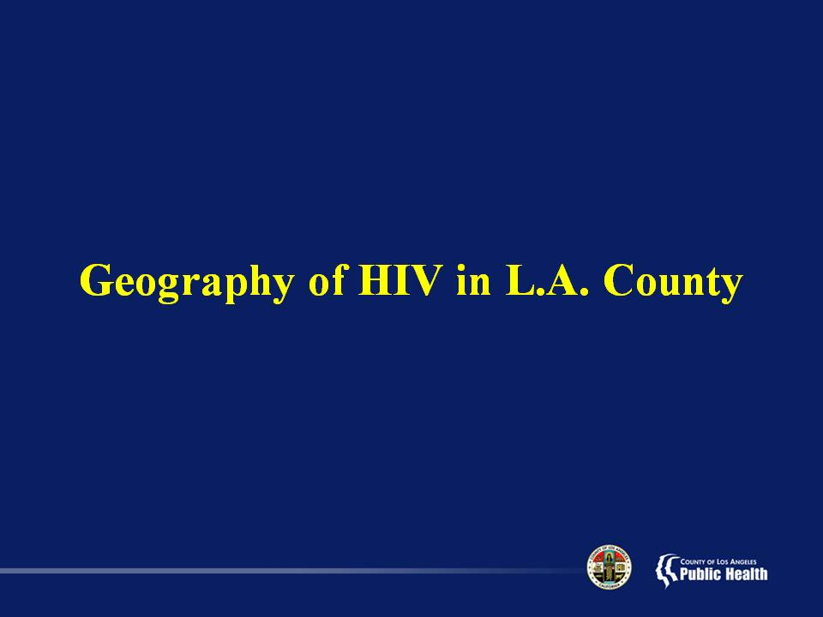

Slide 32
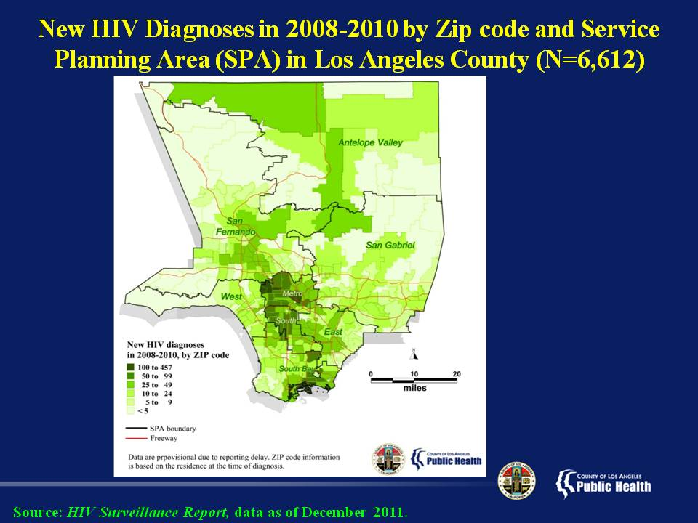
Notes:
This slide shows the number of new HIV diagnoses, including concurrent HIV/AIDS diagnoses, by zip code and Service Planning Area (SPA) in Los Angeles County from 2008-2010.
Areas with the greatest number of persons diagnosed are shaded in dark green, followed by decreasing concentrations depicted in incrementally lighter shades of green.
The highest concentration of new diagnoses reside in the Metro and South SPAs, followed by large concentrations in the South Bay and San Fernando Valley SPAs.
Please note that data are provisional due to reporting delays. Zip code information is based on the residence at the time of HIV or AIDS diagnosis, or the most recently reported residential information.

Slide 33
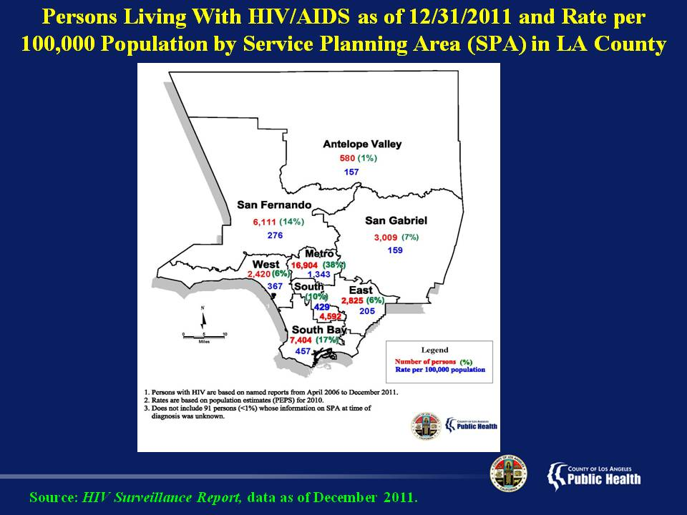
Notes:
This slide shows the number (in red), percent (in green), and rate per 100,000 population (in blue) of persons living with HIV/AIDS in Los Angeles County by Service Planning Area (SPA) as of December 2011. Note that the total population includes persons with missing SPA information, thus the sum of the numbers from each SPA does not equal to 43,936.
SPA 4 (Metro) has the highest number (16,904), proportion (38%), and rate (1,343 per 100,000) of persons living with HIV/AIDS among all SPAs in the county, followed by SPA 8 (South Bay) with 7,404 people (17%), and a rate of 457 per 100,000. SPA 1 (Antelope Valley) has the lowest number (580), percent (1%), and rate (157 per 100,000) of people living with HIV/AIDS in Los Angeles County.

Slide 34
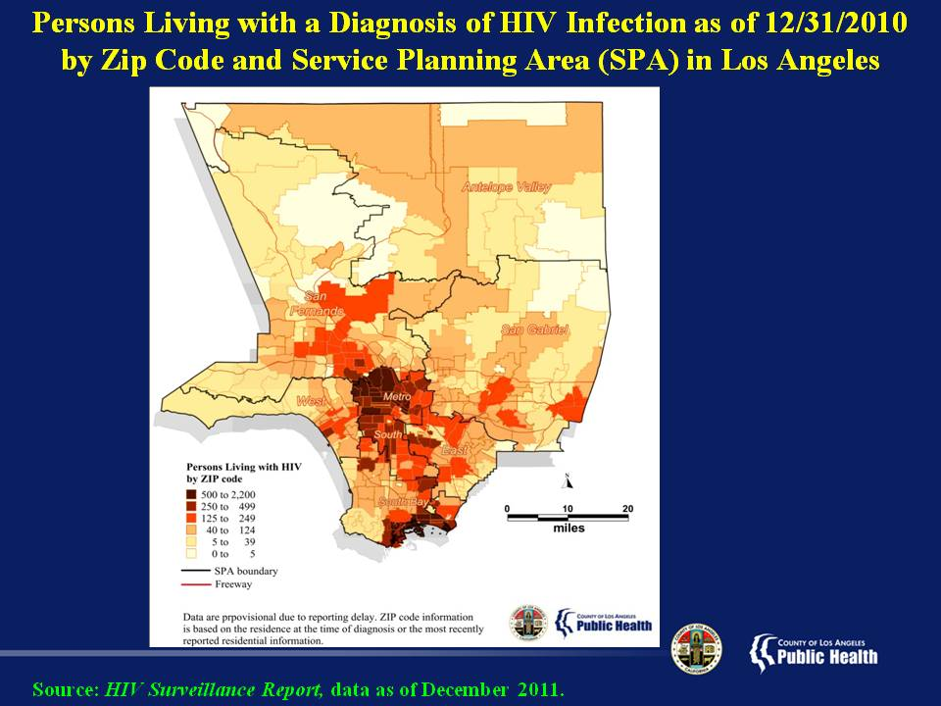
Notes:
This slide shows the number of persons living with a diagnosis of HIV infection by zip code and SPA in Los Angeles County as of December 31, 2010.
Zip codes with the greatest number of people living with HIV infection are shaded in dark red, as seen in SPA 4 (Metro) and in SPA 8 (South Bay).
Other zip codes that have less, but still large numbers of people living with HIV infection (shaded in brown and orange) are located in SPA 6 (South), and in parts of SPAs 2 (San Fernando Valley), 5 (West), and 7 (East).
Data are provisional due to reporting delays. Zip code information is based on the residence at the time of HIV or AIDS diagnosis, or the most recently reported residential information.

Slide 35
